Slide 1
NIH Fellowship Applications: Tools for Success
1. NIH fellowship overview
Types of fellowships and eligibility
Factors to consider when applying
Tips from a Program Director
2. Components of a fellowship application/review criteria
3. Writing a competitive application
Prepare to write
Grantsmanship and review criteria
Completing the application
4. Peer review
Scoring system
Summary statement
Institute funding pay-lines

Slide 2
Grant Funding for Trainees
Predoctoral
Postdoctoral
Early Stage PI
F30 *, F31 *
F32 *
K awards
Institutional Awards: R25 , T32, K12
*National Research Service Awards (NRSA)
Courtesy of Susan Perkins, PhD, NCI Training Division

Slide 3
1. NRSA Fellowship (Fs) Overview
The Ruth L. Kirschstein National Research Service Award (NRSA) is a congressionally mandated program
Provide research training support for:
Predoctoral trainees enrolled in a PhD program (F31)
Predoctoral trainees enrolled formal dual doctoral degree program (MD/PhD, DDS/PhD) (F30)
Postdoctoral fellows (F32)
Offerings vary by institute
Training award, not a research award
For individuals committed to a career in research
U.S. citizenship or green card required
Courtesy of Susan Perkins, PhD, NCI Training Division

Slide 4
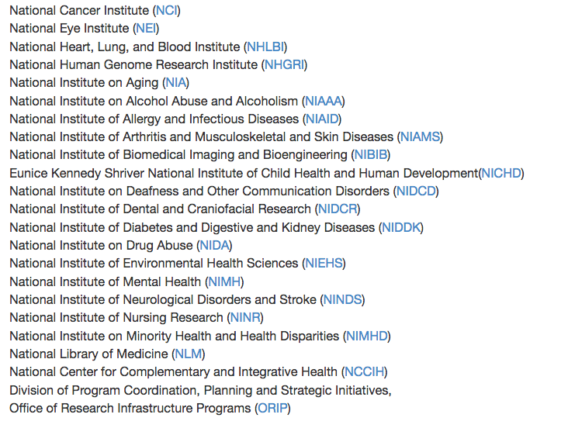
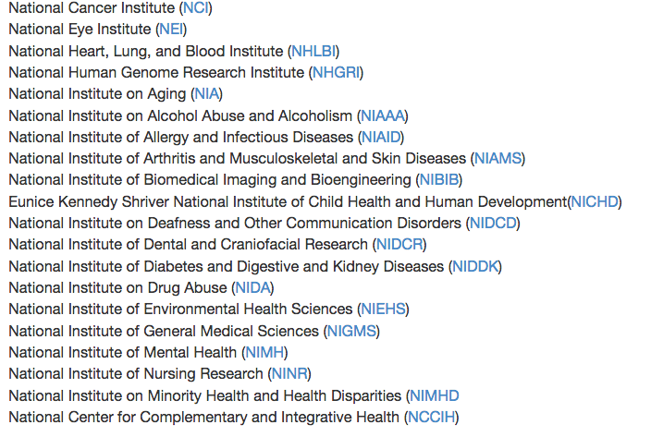
Participating Institutes
F31
F32
https://grants.nih.gov/grants/guide/pa-files/PA-16-309.html
https://grants.nih.gov/grants/guide/pa-files/PA-16-307.html
As of Jan 3, 2019

Slide 5
NRSA Fellowships Provide:
Stipend (full-time effort required)
Predocs (F30 or F31): $24,324 per year for up to 5 or 6 years
Postdocs (F32): $48,432-$59,736 per year for up to 3 year
Partial tuition and fees
60%, up to $16,000 (F30 and F31) or $4,500 (F32)
Funds for training-related expenses (primarily health insurance, travel)
$4,500 for predocs, $9850 for postdocs
Courtesy of Susan Perkins, PhD, NCI Training Division

Slide 6
Fellowship applications: factors to consider
Sponsor funding
Fs do not fund the research project; therefore, priority is given to applications for which the sponsor has R01 or equivalent research funding
Time of submission
F30: typically in year 4 of a dual degree program
F31: typically in year 3 of a PhD program
F32: typically in 1st or 2nd year of a postdoc fellowship
Publications
F30s and F31s: 40-50% of successful applicants have at least one 1st author publication
F32s : 60% of successful applicants have 3 or more 1st author publications
Courtesy of Susan Perkins, PhD, NCI Training Division

Slide 7
Beware of Scientific Overlap!
The proposed research should derive from the collaborative intellectual input of both applicant and sponsor(s). It cannot solely be a research project previously devised by one of more of the sponsors.
Extensive text duplication between the fellowship and sponsor’s application, or rewording large sections while retaining the scientific goals and objectives, is unacceptable.
Courtesy of Susan Perkins, PhD, NCI Training Division

Slide 8
NRSA Review criteria
Applicant qualifications
Sponsor qualifications
Research Training Plan
Training Potential
Environment and Institutional Commitment to research
“A fellowship is a research project that is integrated with a training plan. The review will focus on the applicant’s potential for a productive career, the applicant’s need for the proposed training, and the degree to which the research project and the training plan, the sponsor(s), and the environment will satisfy those needs.” Susan Perkins, PhD, NCI Training Division

Slide 9
Tips from a Program Director
Know the due dates
April 8, August 8, December 8 by 5 pm local time
Contact your program director early to discuss
Provide your CV or NIH Biosketch and a draft of your specific aims
Work closely with your sponsor and co-sponsor
They write part of the application
Contact your reference letter writers (referees) early
Minimum or 3 letters required; up to 5
Due by 5 pm local time on due date
Courtesy of Susan Perkins, PhD, NCI Training Division

Slide 10
2. Components of the Application
Applicants Background and Goals for Training
Research Experience
Training Goals and Objectives
Activities Planned Under This Award
Specific Aims and Research Strategy
Tailored to the applicant’s experience level
Sponsor and Co-Sponsor Statements
Institutional Environment and Commitment to Training
Letters of Support (Collaborators, consultants, etc)
Not the same as reference letters
Should describe substantive role and contribution to research plan and/or research training
Courtesy of Susan Perkins, PhD, NCI Training Division

Slide 11
Courtesy of Susan Perkins, PhD, NCI Training Division

Slide 12
Read the Funding Opportunity Announcement (FOA)
Table of IC-Specific Information, Requirements, and Staff contacts:https://grants.nih.gov/grants/guide/contacts/parent_F31.html
Read the SF424 Application Form Instructions
https://grants.nih.gov/grants/how-to-apply-application-guide.html
Courtesy of Susan Perkins, PhD, NCI Training Division

Slide 13
3. Writing a Competitive Application
Summary: before you start
Speak with Agency Program Director
Speak with Colleagues who are awardees
Review funded applications if possible
Review agency’s review criteria
Strengthen pilot data
Identify who will write letters of reference
Identify what will make the application more competitive
Become informed about career development opportunities, courses, etc. that will enhance your training
Become informed core facilities/research resources

Slide 14
Components of an Outstanding Application
Research that is Feasible, Relevant, Unique, Innovative, Clear and Consistent
An explicitly stated hypothesis
A list of specific aims and objectives that will be used to examine the hypothesis
A discussion of rationale and potential impact
A description of the methods/approaches/techniques to address each aim
A logical outline and well-designed figures
A discussion of limitations and challenges and how they will be addressed
An organized research and career developmental plan
Review by mentor/colleagues prior to submission

Slide 15
Title and Abstract
Title: Straightforward, clear, usually partially-understandable even to non-expert (not always to layperson)
Abstract: read by most (not likely all of study section); anyone in study section who is going to comment on (support/criticize) your grant will read/skim the abstract
Consider conveying 4 things in your Abstract
What is the important topic?
What is known?
What is unknown?
What are you going to do?
Title and Abstract should NOT be an after-thought! Often the TITLE and ABSTRACT determine which study section your application ends up in!

Slide 16
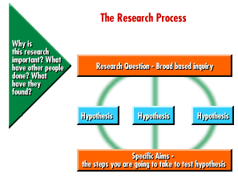
Specific Aims and Hypotheses

Slide 17
Hypotheses
State your question as a Hypothesis
What hypotheses are you intending to test?
Why are your hypotheses interesting?
Are your hypotheses testable?
Will your Aims suitably address your hypotheses?

Slide 18
Specific Aims
State concisely the goals of the proposed research and summarize the expected outcome(s), including the impact that the results of the proposed research will exert on the research field(s) involved
List succinctly the specific objectives of the research proposed, e.g., to test a stated hypothesis, create a novel design, solve a specific problem, challenge an existing paradigm or clinical practice, address a critical barrier to progress in the field, or develop new technology
Specific Aims are limited to one page

Slide 19
Research Strategy
Is the proposed research project of high specific quality and is it well integrated with the research training plan?
Is the project significantly distinct from the sponsors funded research? Beware of overlap!
Is the research project consistent with the applicants stage of research development?
Is the proposal time frame feasible to accomplish the proposed training?

Slide 20
Research Strategy
Goal: A tailored research training plan, including a description of the research strategy (preferably hypothesis-driven) well-suited to the stage of applicant’s career development
Approach: for each Aim include
Rationale- for subaims and proposed studies
Background/preliminary results
Methods/Statistics
Expected outcomes and interpretation
Potential pitfalls and alternative strategies

Slide 21
Fellowship Applicant
Are the applicant's academic record and research experience of high quality?
Does the applicant have the potential to develop into an independent and productive researcher in biomedical, behavioral or clinical science?
Does the applicant demonstrate commitment to a career as an independent researcher in the future?

Slide 22
Selection of Sponsor/co-Sponsor
Think: research expertise, training experience and success
If mentor is an Assistant Professor, may need to choose add’l senior person
Mentoring teams (committees) are sometimes appropriate
Are the sponsor(s’) research qualifications (including recent publications) and track record of mentoring individuals at a similar stage appropriate for the needs of the applicant?
Is there evidence of a match between the research interests of the applicant and the sponsor(s)?
Do the sponsor(s) demonstrate an understanding of the applicant’s training needs as well as the ability and commitment to assist in meeting these needs?
Is there evidence of adequate research funds to support the applicant’s proposed research project and training for the duration of the fellowship?

Slide 23
Goals for Fellowship Training and Career
Think: Thesis committee composition, conferences, coursework, publications, national meetings, professional skill development
Is the proposed research plan of high scientific quality?
Does it relate to the applicant's training plan?
Is the training plan consistent with the applicant's stage of research development?
Will the research training plan provide the applicant with individualized and supervised experiences that will develop research skills needed for his/her independent and productive research career?

Slide 24
Training Potential
Does the proposed research training plan have
the potential to provide the applicant fellow with
the requisite individualized and supervised
experiences that will develop his/her research skills?
Does the proposed research training have the potential to serve as a sound foundation that will lead the applicant fellow to an independent and productive career?

Slide 25
Institutional Environment & Commitment to Training
Are the research facilities, resources (e.g. equipment, laboratory space, computer time, subject populations), and training opportunities (e.g. seminars, workshops, professional development opportunities) adequate and appropriate?
Is the institutional environment for the applicant’s scientific development of high quality? Is there appropriate institutional commitment to fostering the applicant's mentored training toward his/her research career goals?

Slide 26
Other Sections
Biosketch
Budget
Vertebrate Animals/Human Subjects
Letters of reference: Provide program announcement number, NIH commons user name, update CV, specific aims
Responsible Conduct of Research: Ethics classes to be taken

Slide 27
4. Peer Review

Slide 28
Ctr for scientific review (CSR)

Slide 29
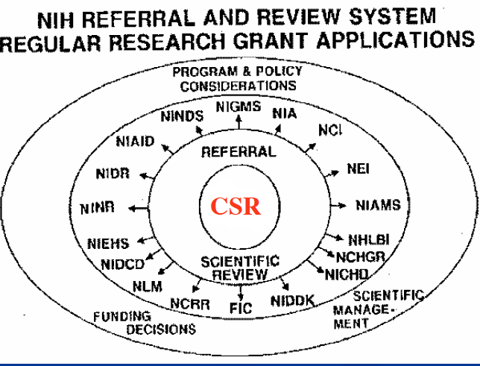
Center For Scientific Review (CSR)
The portal for NIH grant applications and their initial review for scientific merit. Organizes the peer review study sections that evaluate the majority of NIH applications. Not tied to a specific NIH institute. Their mission is to see that NIH grant applications receive fair, independent, expert, and timely reviews -- free from inappropriate influences -- so NIH can fund the most promising research.

Slide 30
Study Section
Selected reviewers (expertise & availability)
In some cases can be broad in expertise
Each reviewer assigned grants ahead of time
‘Triage’ those with poor (high) scores
Review the remainder
1-2 days (exhausting)

Slide 31
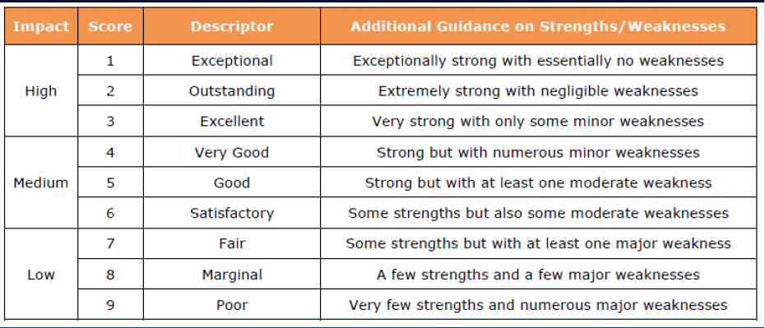
NIH Study Section Scale 1-9

Slide 32
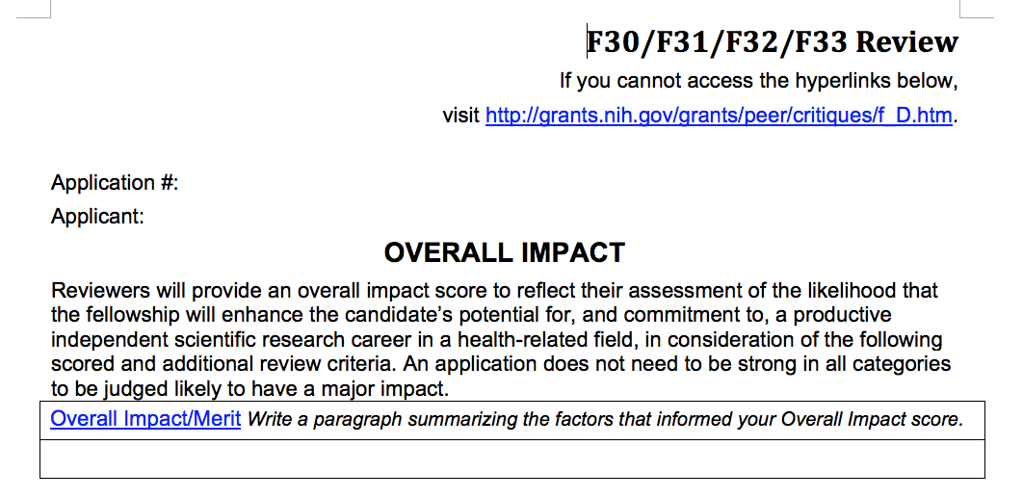
Reviewer’s overall assessment “that the fellowship will enhance the applicant’s potential for, and commitment to, an independent scientific research career”.
Comments on the Applicant’s need for the proposed training and the likelihood that the research project, training plan, sponsor and environment will meet that need.
https://grants.nih.gov/grants/peer/critiques/f_D.htm

Slide 33
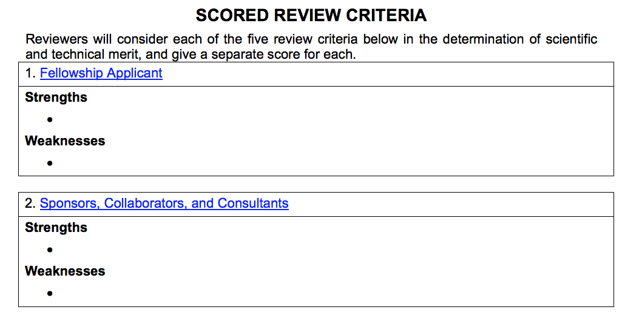
How strong are the Applicant’s academic record and research experiences?
Does the applicant have the potential to develop into an independent and successful researcher?
Is the applicant committed to a research career (in field X)?
https://grants.nih.gov/grants/peer/critiques/f_D.htm

Slide 34
Does the sponsor have the research qualifications (including recent publications) to provide a good training environment?
Does the sponsor have mentoring experience appropriate for the needs of the applicant?
Does the sponsor demonstrate an understanding of of the applicants training needs and the ability and commitment to assist in meeting those needs?
https://grants.nih.gov/grants/peer/critiques/f_D.htm

Slide 35
Is the proposed research project of high scientific quality, and is it well integrated with the proposed research training plan?
Is the research project consistent with the applicant's stage of research development?
Is the proposed time frame feasible to accomplish the proposed training?
https://grants.nih.gov/grants/peer/critiques/f_D.htm

Slide 36
Are the proposed research project and training plan likely to provide the applicant with the requisite individualized and mentored experiences in order to obtain appropriate skills for a research career?
Does the training plan take advantage of the applicant’s strengths, and address gaps in needed skills?
Does the training plan document a clear need for, and value of, the proposed training?
Does the proposed training have the potential to serve as a sound foundation that will clearly enhance the applicant’s transition to the next career stage and enhance the applicant’s ability to develop into a productive researcher?
https://grants.nih.gov/grants/peer/critiques/f_D.htm

Slide 37
Are the research facilities, resources (e.g. equipment, laboratory space, computer time, subject populations), and training opportunities(e.g. seminars, workshops, professional development opportunities) adequate and appropriate?
Is the institutional environment for the applicant’s scientific development of high quality?
Is there appropriate institutional commitment to fostering the applicant’s mentored training?
https://grants.nih.gov/grants/peer/critiques/f_D.htm

Slide 38
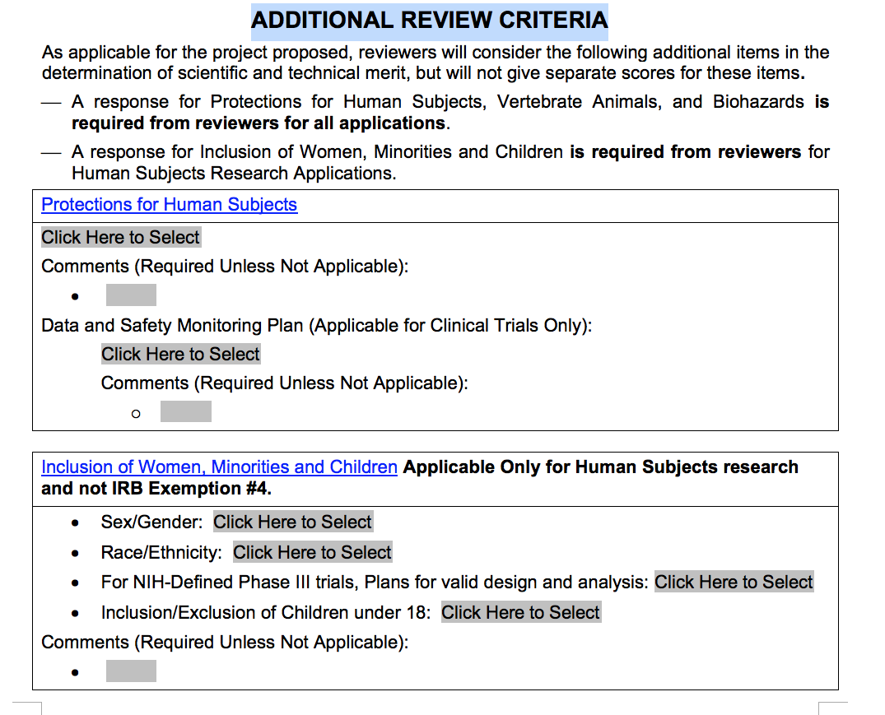
https://grants.nih.gov/grants/peer/critiques/f_D.htm

Slide 39
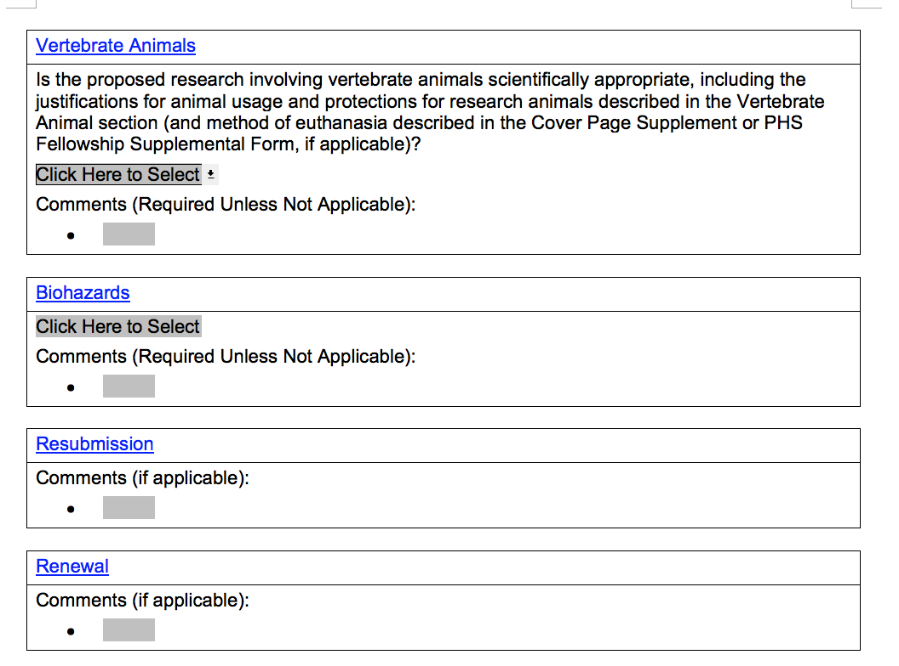
https://grants.nih.gov/grants/peer/critiques/f_D.htm

Slide 40
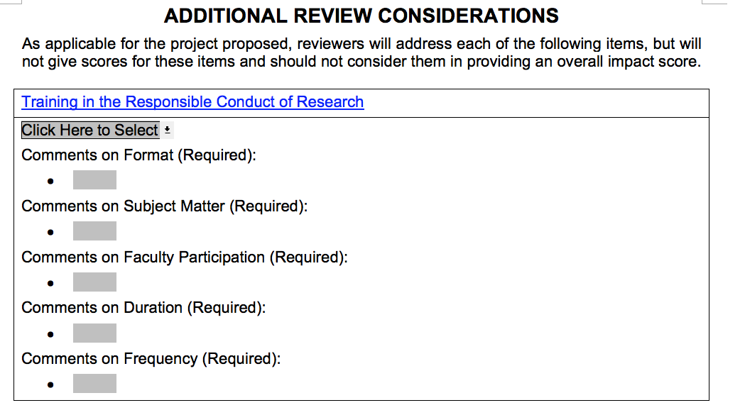
https://grants.nih.gov/grants/peer/critiques/f_D.htm

Slide 41
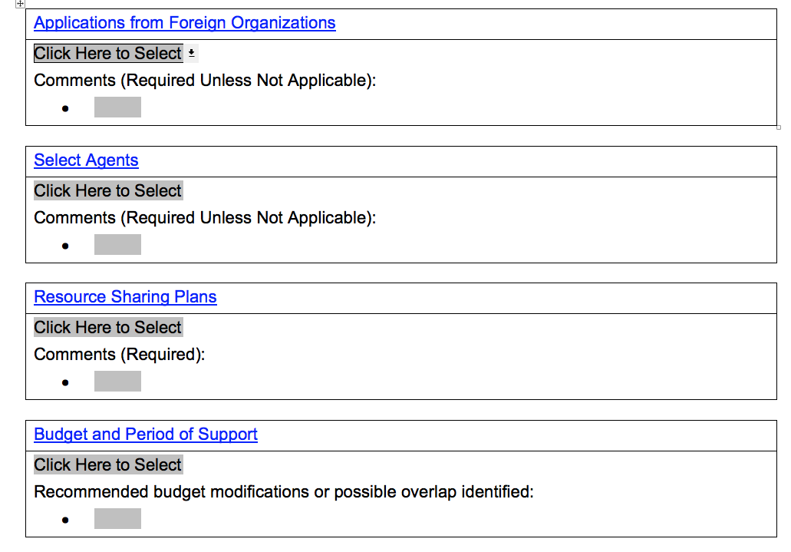
https://grants.nih.gov/grants/peer/critiques/f_D.htm

Slide 42
https://grants.nih.gov/grants/peer/critiques/f_D.htm

Slide 43
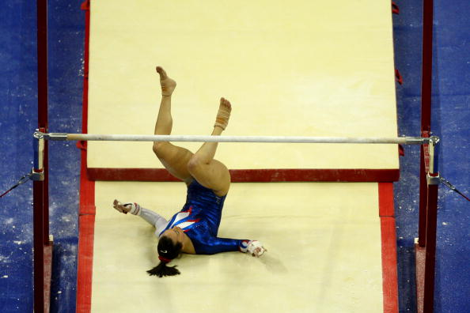
Study Section Outcomes
Discussed applications
Receives Impact/Priority Scores
Receives scores for individual core review criteria (final scores)
Summary statement reflects discussion
Not Discussed applications
Receives scores for individual core review criteria (preliminary scores)
Summary statement is not updated

Slide 45
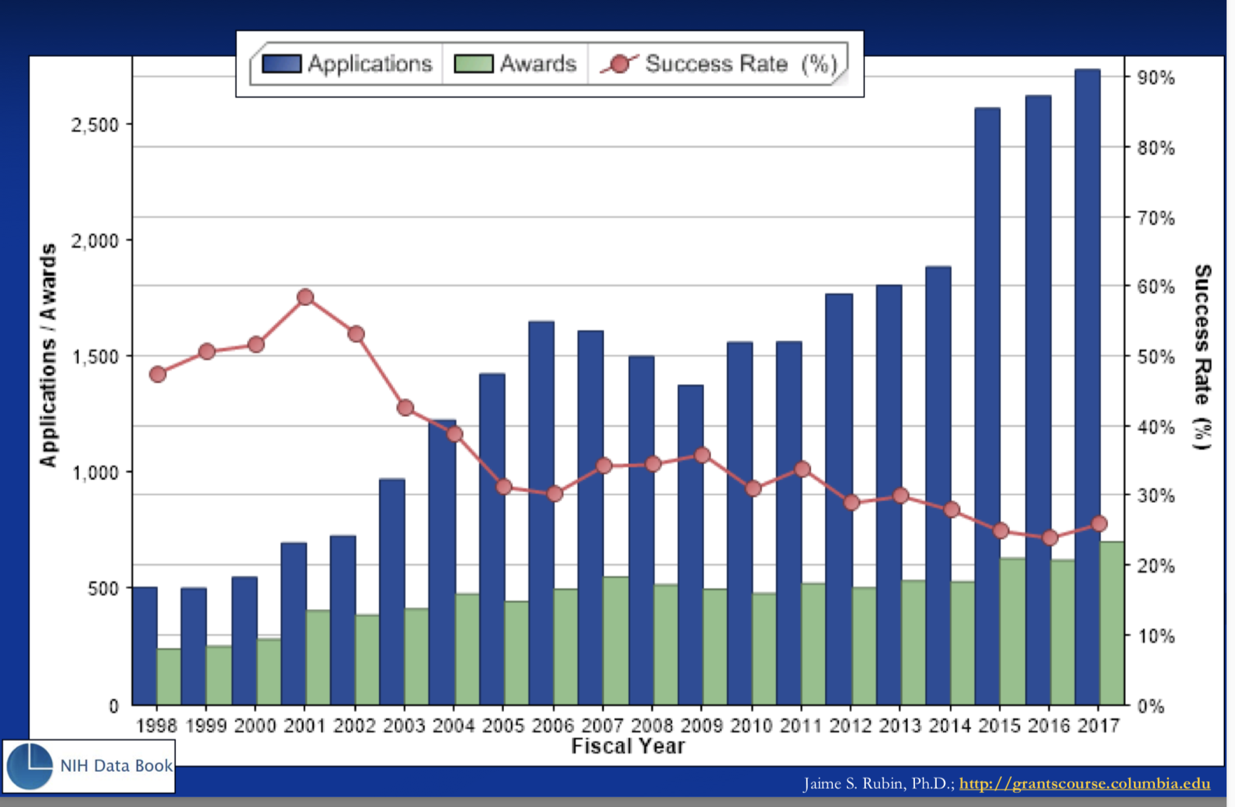
Funding: Pre-doc fellowships (F31)
Peer Review of NIH Research Grants Applications
Peer Review of NIH Research Grants Applications
National Institutes of Health Online Reporting Tool (RePORT)
Jaime S. Rubin, Ph.D.; http://grantscourse.Columbia.edu

Slide 46
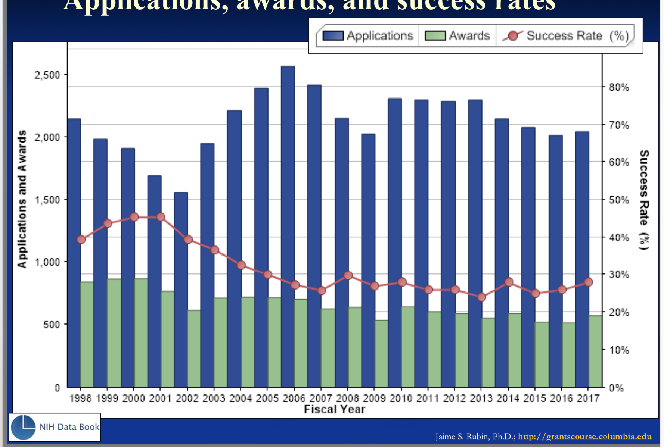
Funding: Post-doc fellowships (F32)
National Institutes of Health Online Reporting Tool (RePORT)
Jaime S. Rubin, Ph.D.; http://grantscourse.Columbia.edu

Slide 47
NRSA INTIATIVE
A program to encourage submission of NRSA’s on our campus and enhance our success rate
Pilot funded by the Vice-Chancellor for Research
Open to trainees in all UC Anschutz schools
Will provide guidance in grant development and objective pre-review of applications
Not a grant writing course

Slide 48
MOCK STUDY SECTION TIMELINE
Sept 10 – letter of intent (LOI) due
Specific aims (one page) and a list of collaborators.
Based on your LOI you will be assigned a “Core” faculty contact person (Core Reviewer).
The CR will be your primary contact throughout the submission process.
The CR will meet with the trainee (and mentor if possible) at least once during the writing process to provide feedback and guidance.

Slide 49
TIMELINE Cont’d
October 28th - full application due
This includes the trainee and the mentors training plan, but not letters of support.
No partial/incomplete applications will be accepted!!!
Mock Study - tentatively the week of Nov 4th. Trainees are required to attend. Mentors are encouraged to attend.

Slide 50
Good Luck!!!

