Slide 1
Rain Meeting
July 15, 2021

Slide 2
System to System
A quick note

Slide 3
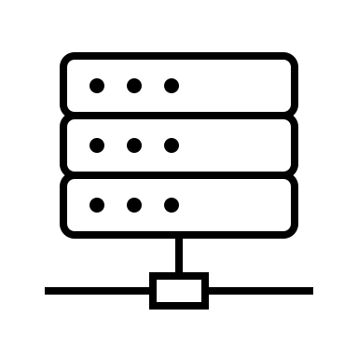
Submission systems for B2B submission
University of Colorado
InfoEd
Grants.gov
eRA.Commons
NIH
Jan 25, 2022 edition
XML File
XML File
Application

Slide 4
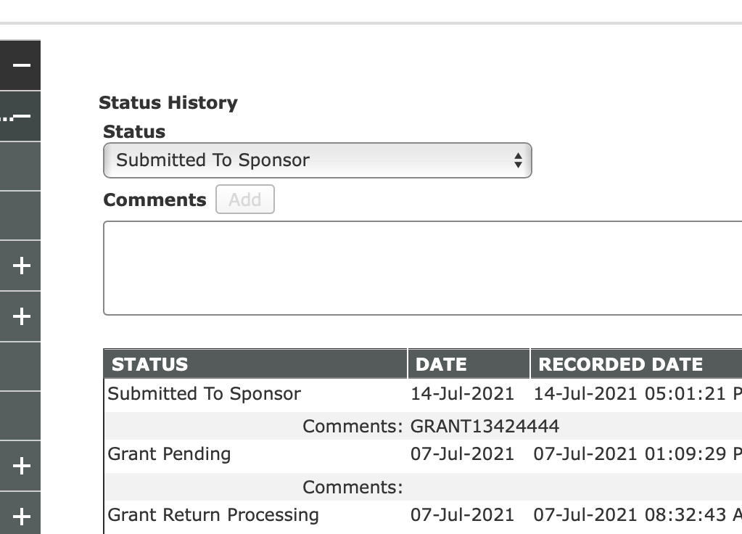
Status History: After submission
University of
Colorado
InfoEd
Grants.gov
NIH
XML File
XML File
Application

Slide 5
Status History: Corrections Mode
University of
Colorado
InfoEd
Grants.gov
NIH
Grant Pending
XML File
XML File
Application

Slide 6
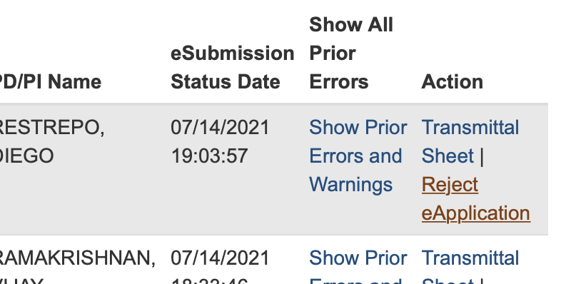
Status History: Withdrawal (before 2 days)
University of
Colorado
InfoEd
Grants.gov
NIH
XML File
XML File
Application

Slide 7
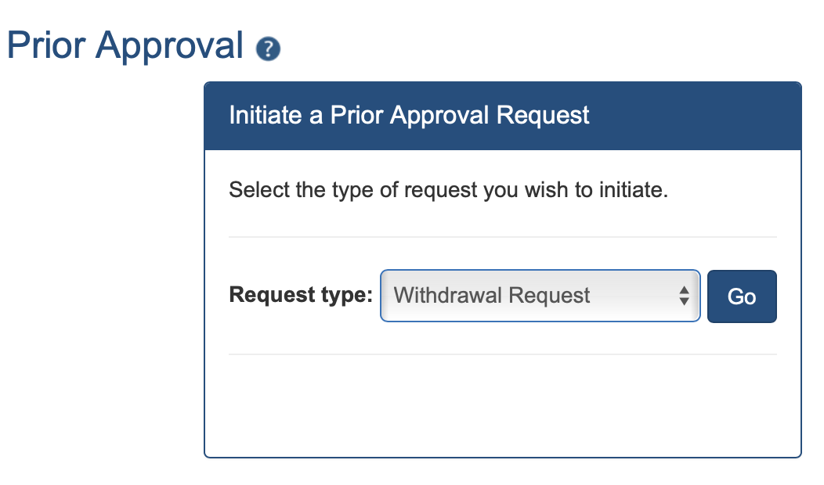
Status History: Withdrawal (past 2 days)
University of
Colorado
InfoEd
Grants.gov
NIH
XML File
XML File
Application

Slide 8
NIH, more things change
The world might end on Jan 25, 2022 edition…

Slide 9
NOT-OD-21-109
eRA Commons IDs to All Senior/Key Personnel
Targeting due dates on or after January 25, 2022, NIH, AHRQ, FDA, and ORD/VA will require all individuals listed on the R&R Senior/Key Person Profile (Expanded) Form to have an eRA Commons username
Why? conflicts of interest in peer review (But conflicts of interest)
So, before Jan 25 it’s a Warning, after it’s going to be an ERROR

Slide 10
NOT-OD-21-073
NIH will require the use of the updated format pages for the previously mentioned submissions for anything on and after January 25, 2022.
Now until Jan 25, 2022, submission for JIT, RPPPR and proposal the old format will work.

Slide 11
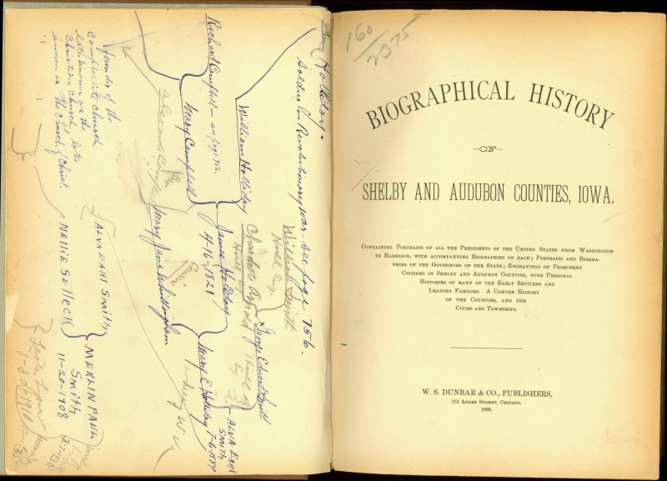
Biographical Sketch Format Page
Biosketches are still limited to 5 pages
Section A: all applicants may include details on ongoing and completed research projects from the past three years that they want to highlight.
Including no more than 5 contributions to science with no more than 4 citations per contribution
Section B ‘Positions and Honors’ has been renamed ‘Positions, Scientific Appointments, and Honors’.

Slide 12
Biographical Sketch Format Page
For the non-Fellowship Biosketch, Section D. has been removed.
For the Fellowship Biosketch, Section D has been updated to remove ‘Research Support.’

Slide 13
Other Support Format Page: Translation
If they are not in English, recipients must provide translated copies. This supporting documentation must be provided as part of the Other Support PDF following the Other Support Format page.
NIH will accept machine-read translations.

Slide 14
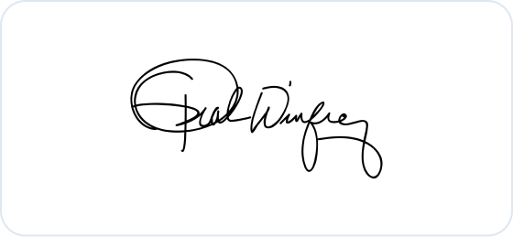
Other Support Format Page: Signature
Signature block added, for Program Director/Principal Investigator or Other Senior/Key Personnel to certify the accuracy of the information submitted.
Each PD/PI or senior/key personnel must electronically sign their respective Other Support form as a PDF prior to submission.

Slide 15
JIT Other Support Hint and Tricks: Signatures
Signatures
After Jan 25, 2022, no signature, no submission
Incorrect data, after Jan 25, 2022, we can’t change the document because it’s been signed
Attachments should be submitted as a flattened PDF, after all signatures are obtained. Applicants and recipients must maintain the original electronic signature and make it available upon request.

Slide 16
Other Support: Signature
Electronic signature ok on Other Support?
Other Support submissions at Just-in-Time and in the RPPR must be submitted as a flattened PDF, after all signatures are obtained.
All principal investigators and other senior/key personnel must electronically sign the Other Support form, prior to its submission to NIH, certifying that the information is accurate and complete

Slide 17
NIH Guidance for Other Support Page
NIH emphasizes that Other Support includes ALL resources made available to a researcher in support of and/or related to all their research endeavors.
Reporting of Other Support is required for all individuals designated in an application as senior/key personnel and is not required for individuals categorized as Other Significant Contributors.
Other support does not include training awards, prizes, or gifts.

Slide 18
NIH Guidance for Other Support Page
List total amounts: Researcher’s should list the total award amount, direct and indirect, for the entire project period, based on the most recent Notice of Award specific to that project.

Slide 19
Biosketch NIH Validation
eRA systems validate:
Whether a biosketch is attached for each and every Sr/Key person listed in the application
That each biosketch is less than or equal to 5 pages
That your biosketch attachment is in PDF format

Slide 20
JIT Other Support Hint and Tricks: Review
Calendar months
Number of calendar months will be reviewed, if wrong email will be sent to Dept/PI

Slide 21
JIT Review
After Nov 5, 2021, we will remind about the signature needed and change in format, but still submit.
If your PI submitted a Just-In-Time, including Other Support, prior to January 25, 2022, but the award has not been issued you do NOT need to re-submit on the updated form.
JIT examples - https://grants.nih.gov/faqs#/biosketches.htm?anchor=alphaHeader4026

Slide 22
Formstack
It’s a stack of forms!!!

Slide 23
Form Stack
Formstack Routing for Subcontract RPPRs: If the prime site requests a new LOI as a part of the RPPR submission(UCD is the subcontract site), do we route through Formstack for OGC’s signature on the LOI?
I depends-
YES - If the LOI includes $$$$$ then yes! and include the detailed budget.
YES – If the prime is the NIH
No but it’s almost always Yes… - If there is no money send it directly to Xenia for signature and return.

