Slide 1
The 2024 State of Faculty Shared Governance Report: CU Denver’s Colleges, Schools and Library

Slide 2
Overview and Project Goals
CU Denver Provost office agreed to perform a comprehensive review of shared governance in CU Denver’s Colleges.
The CU Denver Faculty Assembly identified concerns in Faculty Governance.
This work was performed during AY 2023-2024.

Slide 3
Review Process
We organized the project into three modes of investigation
A comprehensive review of CU Denver’s College bylaws.
A survey of 242 (36%) rostered faculty about shared faculty governance in CU Denver’s schools and Colleges.
A series of group interviews with CU Denver’s administrators, faculty leaders, and shared governance groups.
1
2
3

Slide 4
Part 01: A Review of CU Denver’s College By-Laws
We first identified the principles of shared governance to evaluate for the bylaws review:
1
Governance Structures
Compliance with Regent Policies
Faculty Representation
2
3
We carefully reviewed each bylaws from each college* for adherence to these principles by identifying the text that addresses them. Recommendations are based on this work.
*LIB, BUS, CAP, CLAS, SEHD, and SPA.

Slide 5
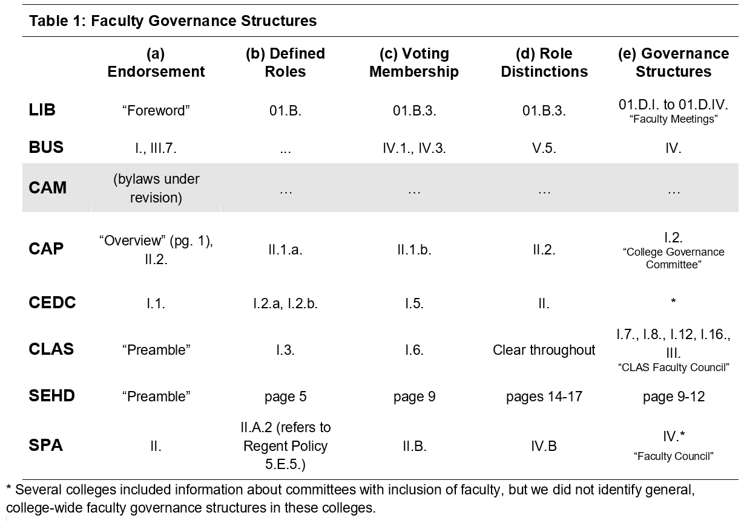
Faculty Governance Structures
Please note: The asterisks indicate a footnote, not provided here. Please refer to the full Faculty Shared Governance Report for these specific details.

Slide 6
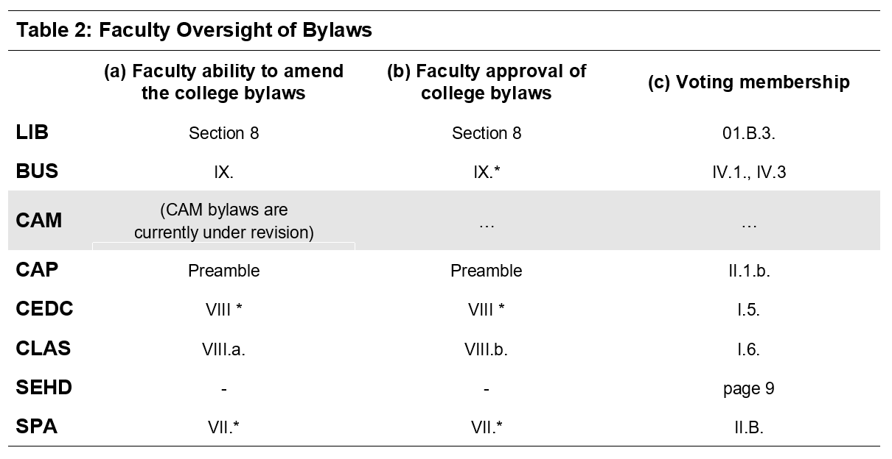
Faculty Oversight of Bylaws
Please note: The asterisks indicate a footnote, not provided here. Please refer to the full Faculty Shared Governance Report for these specific details.

Slide 7
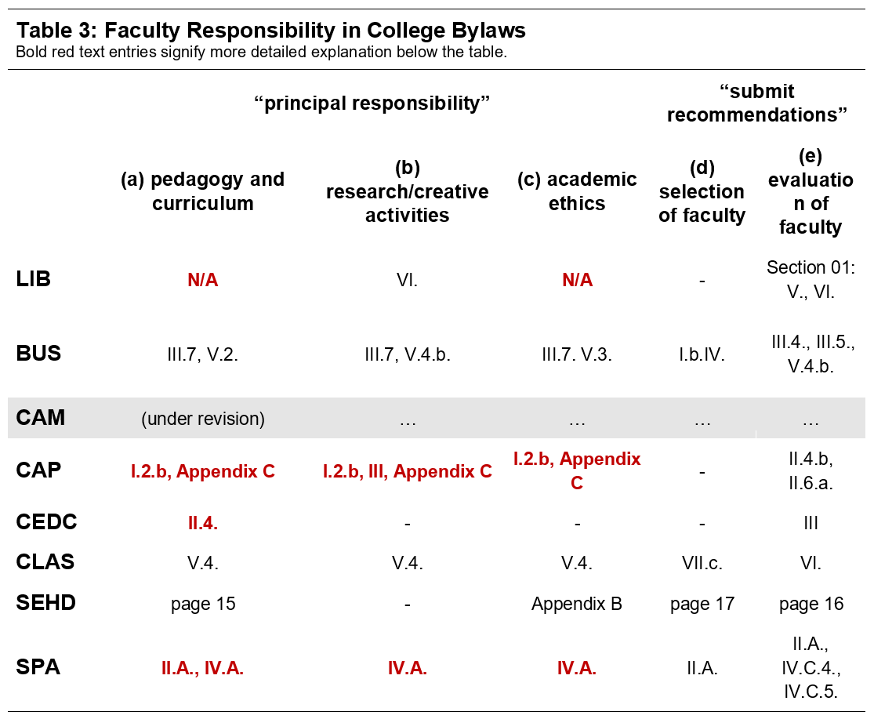
Faculty Responsibility and Authority
Please note: Text highlighted in red indicates a footnote, not provided here. Please refer to the full Faculty Shared Governance Report for these specific details.

Slide 8
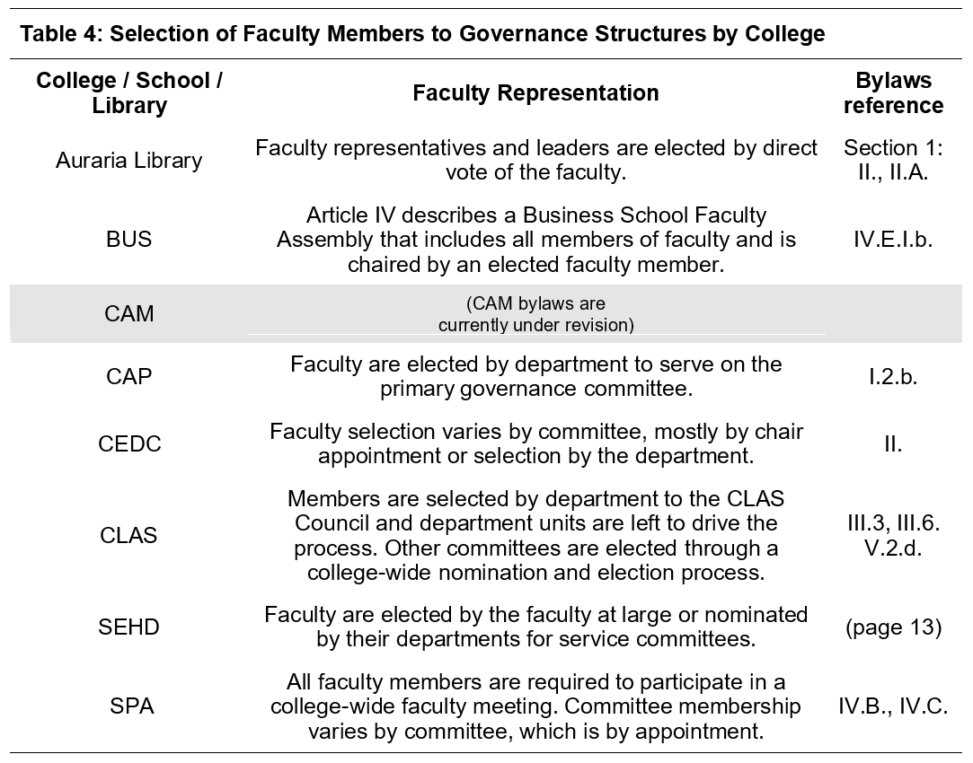
Selection of Faculty to Shared Governance Groups

Slide 9
Recommendations for College Bylaws
1
Each college should establish a faculty governance body
Each college should include provisions requiring a vote open to all members of that college’s faculty to adopt or amend the bylaws.
College-level bylaws should accord faculty members “principal authority” in areas of governance articulated as such in Regent policy.
College-level bylaws should provide a structural mechanism for faculty members to “submit recommendations” for both the selection and evaluation of faculty.
Periodic review and guidance should be provided for college-level bylaws
2
3
4
5

Slide 10
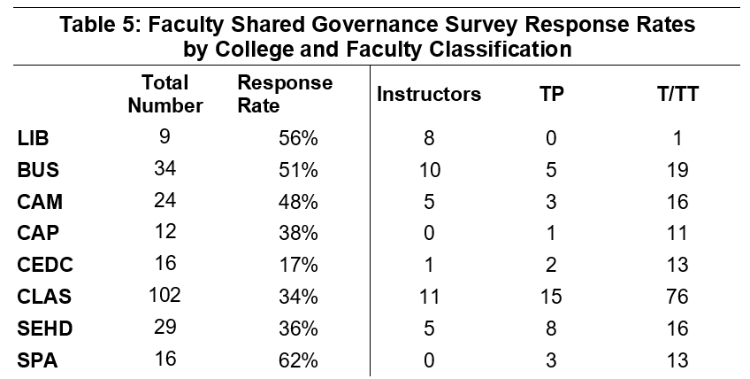
Part 02: Faculty Survey on the State of Shared Governance
We devised an initial survey set to capture ideas and perceptions about the state of shared governance in their school or college.
We sought feedback on the survey from faculty, staff, and university leaders.
The survey was open from February 27 to March 11, 2024.
242 rostered faculty members at CU Denver, representing 36% of the total number, completed the survey.
Open-ended responses were coded into distinct ideas and then summarized.

Slide 11
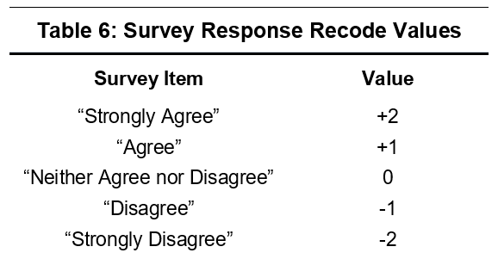
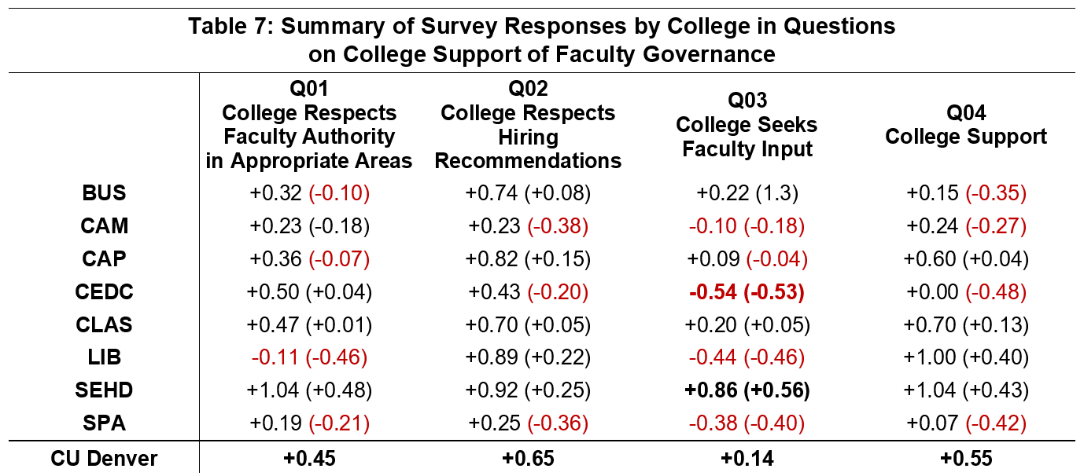
Part 02: Faculty Survey on the State of Shared Governance
Q01: My college/school/library administration respects faculty decisions in areas in which the faculty has principal responsibility (such as pedagogy, curriculum, scholarly or creative work, and academic ethics).
Q02: My college/school/library respects faculty recommendations on the selection and evaluation of faculty.
Q03: My college/school/library administration seeks meaningful faculty input on issues (such as planning) in which the faculty has appropriate interest but not principal responsibility.
Q04: My college/school/library administration supports faculty shared governance.
Please note that in the body of the table:
- Negative numbers are highlighted in red.
-”Unusual” numbers (greater than one standard deviation from the mean) are indicated with bold text.

Slide 12
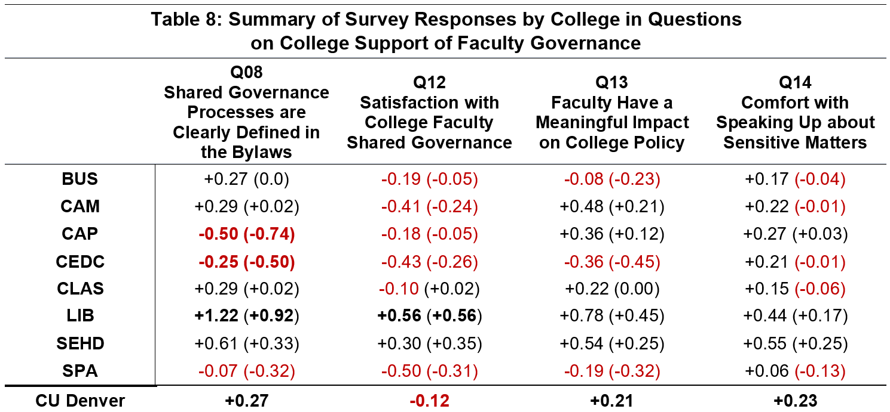
Part 02: Faculty Survey on the State of Shared Governance
Q08: Shared governance processes and responsibilities are clearly defined in college/ school/ library governance documents (e.g., bylaws).
Q12: I am satisfied with the state of faculty shared governance at my college/ school/ library.
Q13: Faculty have a meaningful impact on college/ school/ library policies that matter to me.
Q14: I feel comfortable speaking up in college/ school/ library faculty meetings, even if my position differs from that of administrative leaders.
Please note that in the body of the table:
- Negative numbers are highlighted in red.
-”Unusual” numbers (greater than one standard deviation from the mean) are indicated with bold text.

Slide 13
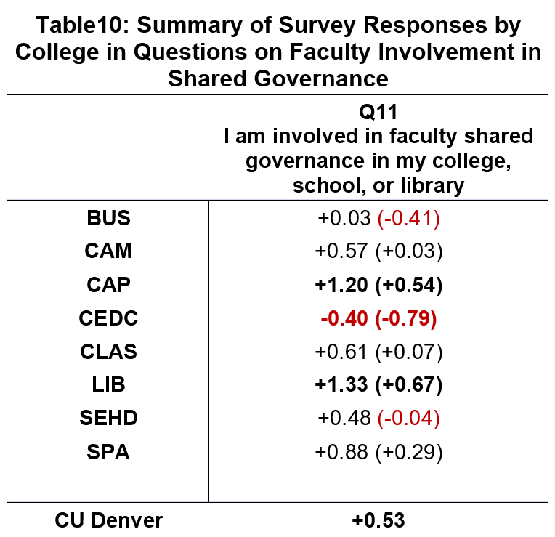
Part 02: Faculty Survey on the State of Shared Governance
Q11: I am involved in faculty shared governance in my college/school/library.
Please note that in the body of the table:
- Negative numbers are highlighted in red.
-”Unusual” numbers (greater than one standard deviation from the mean) are indicated with bold text.

Slide 14
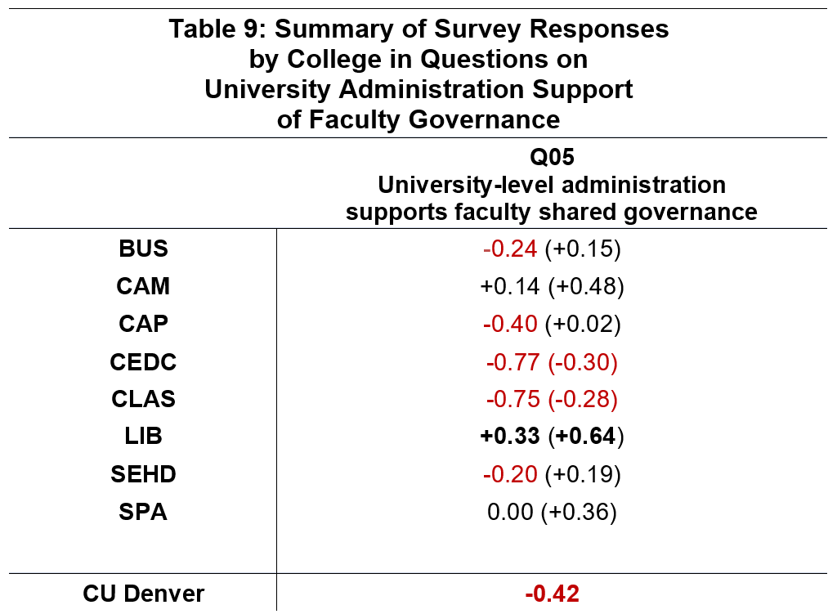
Part 02: Faculty Survey on the State of Shared Governance
Q05: University-level administration supports faculty shared governance.
Please note that in the body of the table:
- Negative numbers are highlighted in red.
-”Unusual” numbers (greater than one standard deviation from the mean) are indicated with bold text.

Slide 15
Part 02: Faculty Survey, Open-Ended Questions
The survey included five questions with optional prompts to enable respondents to elaborate further, as well as two open-response questions:
Please comment below on what you see as faculty shared governance strengths at your college/school/library.
Please comment below on what you see as faculty shared governance weaknesses at your college/school/library.
We coded these open-ended responses into unique ideas to perform a quantitative summary.
1
2

Slide 16
Open-Ended Survey Questions: Strengths of Faculty Governance
(a) there is strong support and respect for shared faculty governance from college administration [1 BUS, 9 CLAS, 5 SEHD, 3 SPA]
(b) there is a strong and well-articulated faculty shared governance committee structure or effective bylaws at the college level [9 CLAS, 3 LIB, 1 SEHD]
(c) there is strong commitment to college-level faculty governance among the faculty itself [1 CEDC, 5 CLAS, 1 LIB, 1 SEHD, 3 SPA]
(d) faculty governance at the college level is strong, healthy, or respected [8 CLAS]
(e) faculty members have the option to participate in governance [1 CEDC, 5 CLAS, 1 LIB, 1SEHD, 3 SPA]
(f) there is strong transparency around governance in the college [1 CEDC, 2 CLAS, 1 LIB, 1 SEHD]

Slide 17
Open-Ended Survey Questions: Weaknesses of Faculty Governance
(a) there is a need for improved engagement with faculty governance from campus-level administration
[1 BUS, 16 CLAS, 1 SEHD];
(b) college administration lacks transparency or should improve communication with faculty
[1 CAM, 4 CEDC, 3 CLAS, 4 LIB];
(c) faculty governance serves only a symbolic purpose to legitimize administrative decisions
[3 CAM, 1 CAP, 6 CLAS, 1 SPA];
(d) there is a need for improved communication and transparency from faculty governance groups
[1 CAM, 7 CLAS];
(e) administration exerts too much authority over some faculty
[1 BUS, 2 CAM, 5 SPA]
(f) there is a lack of awareness among faculty about the roles and functions of shared faculty governance
[1 BUS, 1 CAP, 1 CAM, 2 CLAS, 3 SPA].

Slide 18
Part 03: Leadership and Governance Group Interviews
Methodology:
The project team met with eleven leadership groups in Marcy and April 2024
Participants were provided with a draft copy of the 2024 Shared Governance Report and Survey results
We discussed the state of shared governance and sought feedback
The Project team collated the key themes from meeting notes

Slide 19
Part 03: Leadership and Governance Group Interviews
Major Themes:
Theme 1: Heavy workloads limit the ability of faculty to engage in shared governance in their college.
Theme 2: Shared governance structures vary across schools, colleges, and the library, and need to be periodically reviewed.
Theme 3: Effective shared governance in CU Denver’s colleges, schools, and libraries requires strong faculty governance structures at the campus level, as well as strong support from campus administrators.

Slide 20
Part 03: Leadership and Governance Group Interviews
1. Transparency and communication: Effective communication and transparency between faculty members and school leadership are essential components of shared governance.
2. Budget and resource allocation: There are concerns about budget decisions and the necessity for faculty involvement in matters related to budgeting. There is a desire for greater transparency and faculty input in budgetary decisions.
3. Autonomy in research: Discussions have raised questions related to faculty input concerning research and creative activities. There is a need to balance shared governance principles with academic freedom.
4. Continuous improvement: There is a shared commitment to continuously improving shared governance practices through ongoing dialogue, solicitation of feedback, and periodic reviews of governance structures.
5. Involvement of staff in faculty governance: Several participants advocated for more involvement of staff in shared governance.
6. Closure of the Graduate School: Discussants raised concerns about governance at the Graduate School and its recent disbandment, including concerns about top-down decision-making and the need for more faculty involvement in developing policy concerning the administration of education and curriculum.
7. Manipulation of shared governance: Concern was expressed about ensuring that faculty representative bodies are not manipulated to serve specific interests, rather than those of the broader faculty community. One dean emphasized the importance of maintaining integrity and representing the broader faculty perspective.

Slide 21
Questions and Discussion
The tables and graphics from the survey performed for Part II of the Faculty Shared Governance Report are duplicated on the remaining slides.

Slide 22
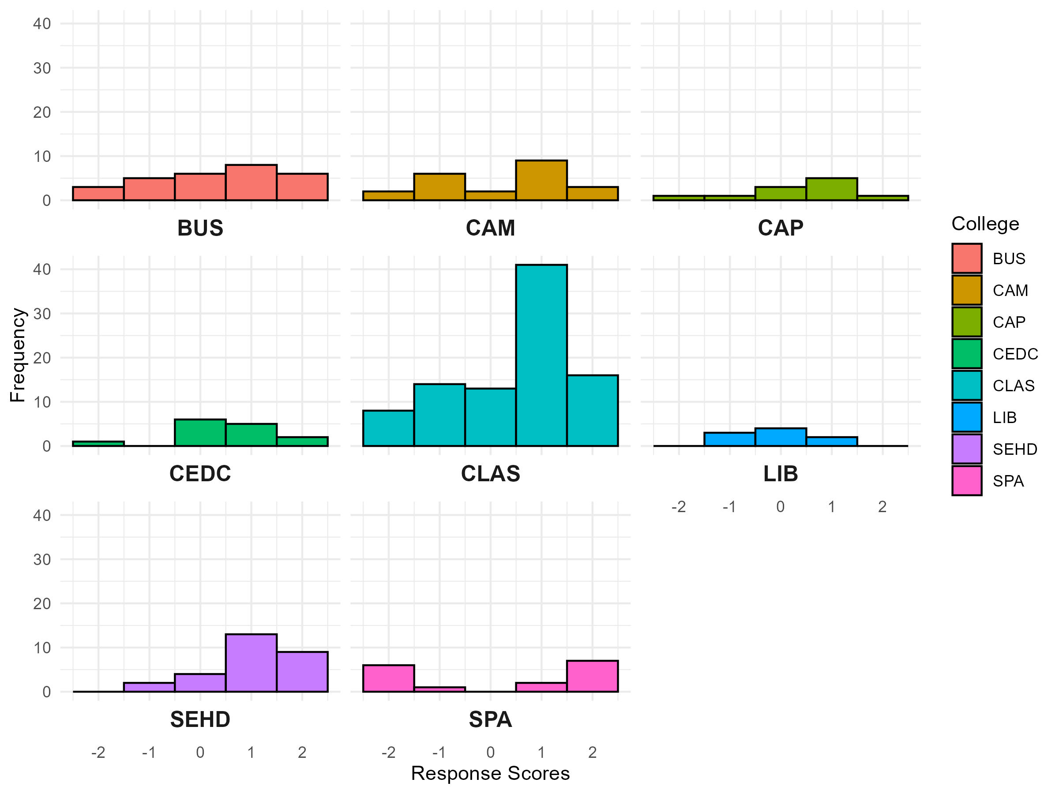
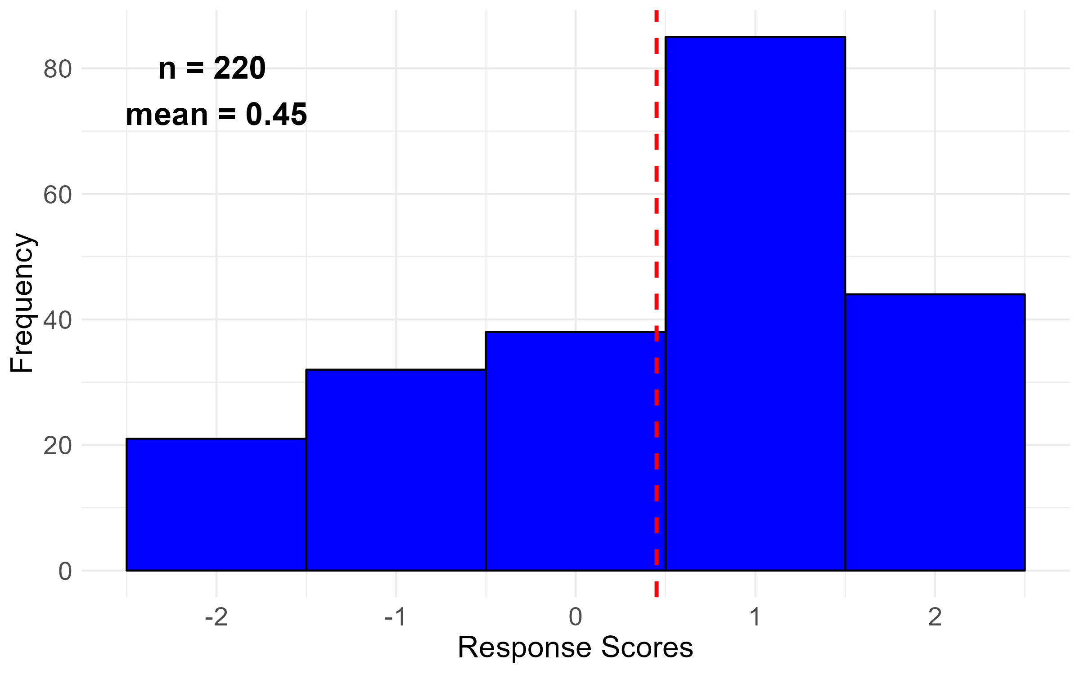
Q01: My college/ school/ library administration respects faculty decisions in areas in which the faculty has principal responsibility (such as pedagogy, curriculum, scholarly or creative work, and academic ethics).

Slide 23
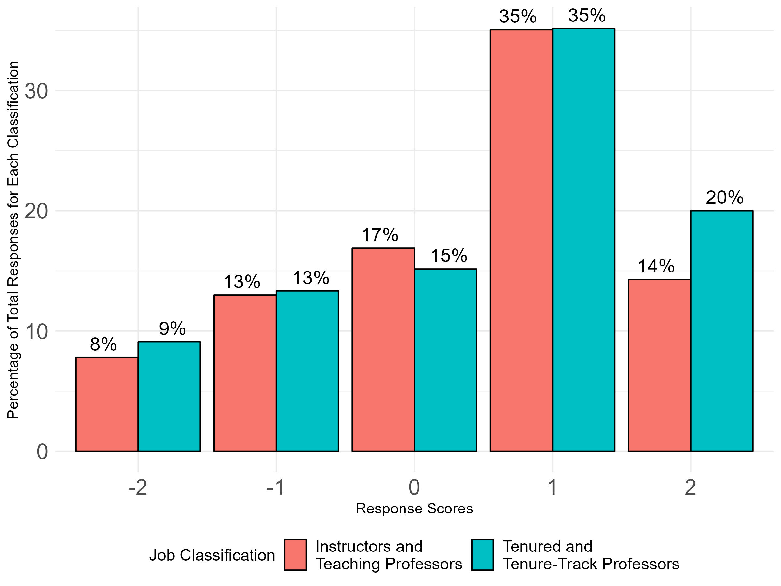
Q01: My college/ school/ library administration respects faculty decisions in areas in which the faculty has principal responsibility (such as pedagogy, curriculum, scholarly or creative work, and academic ethics).
Overall Responses by Job Classification

Slide 24
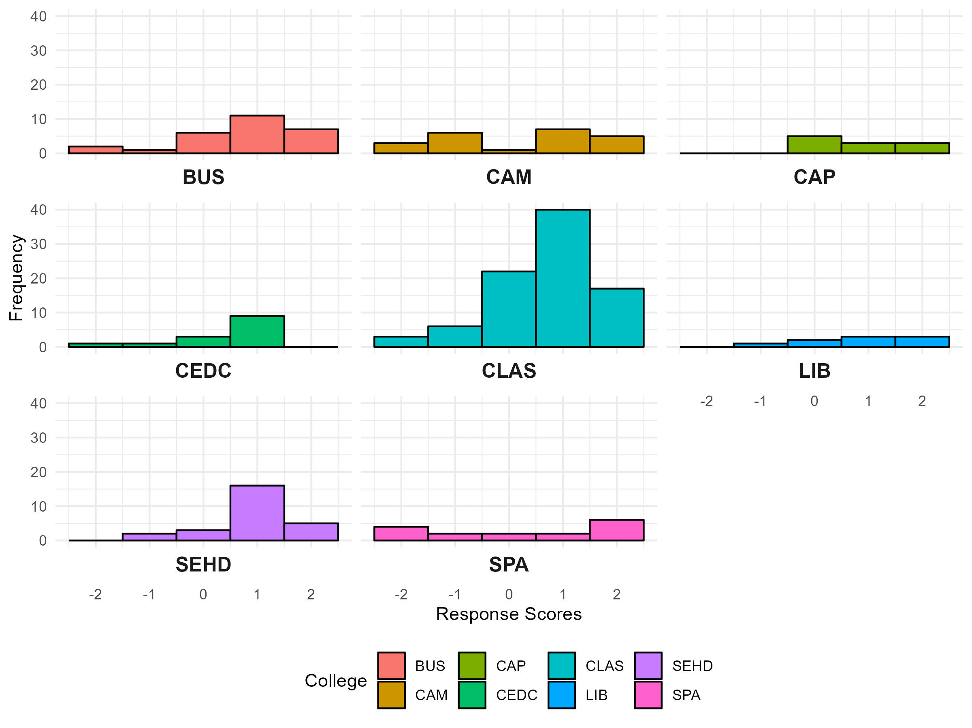
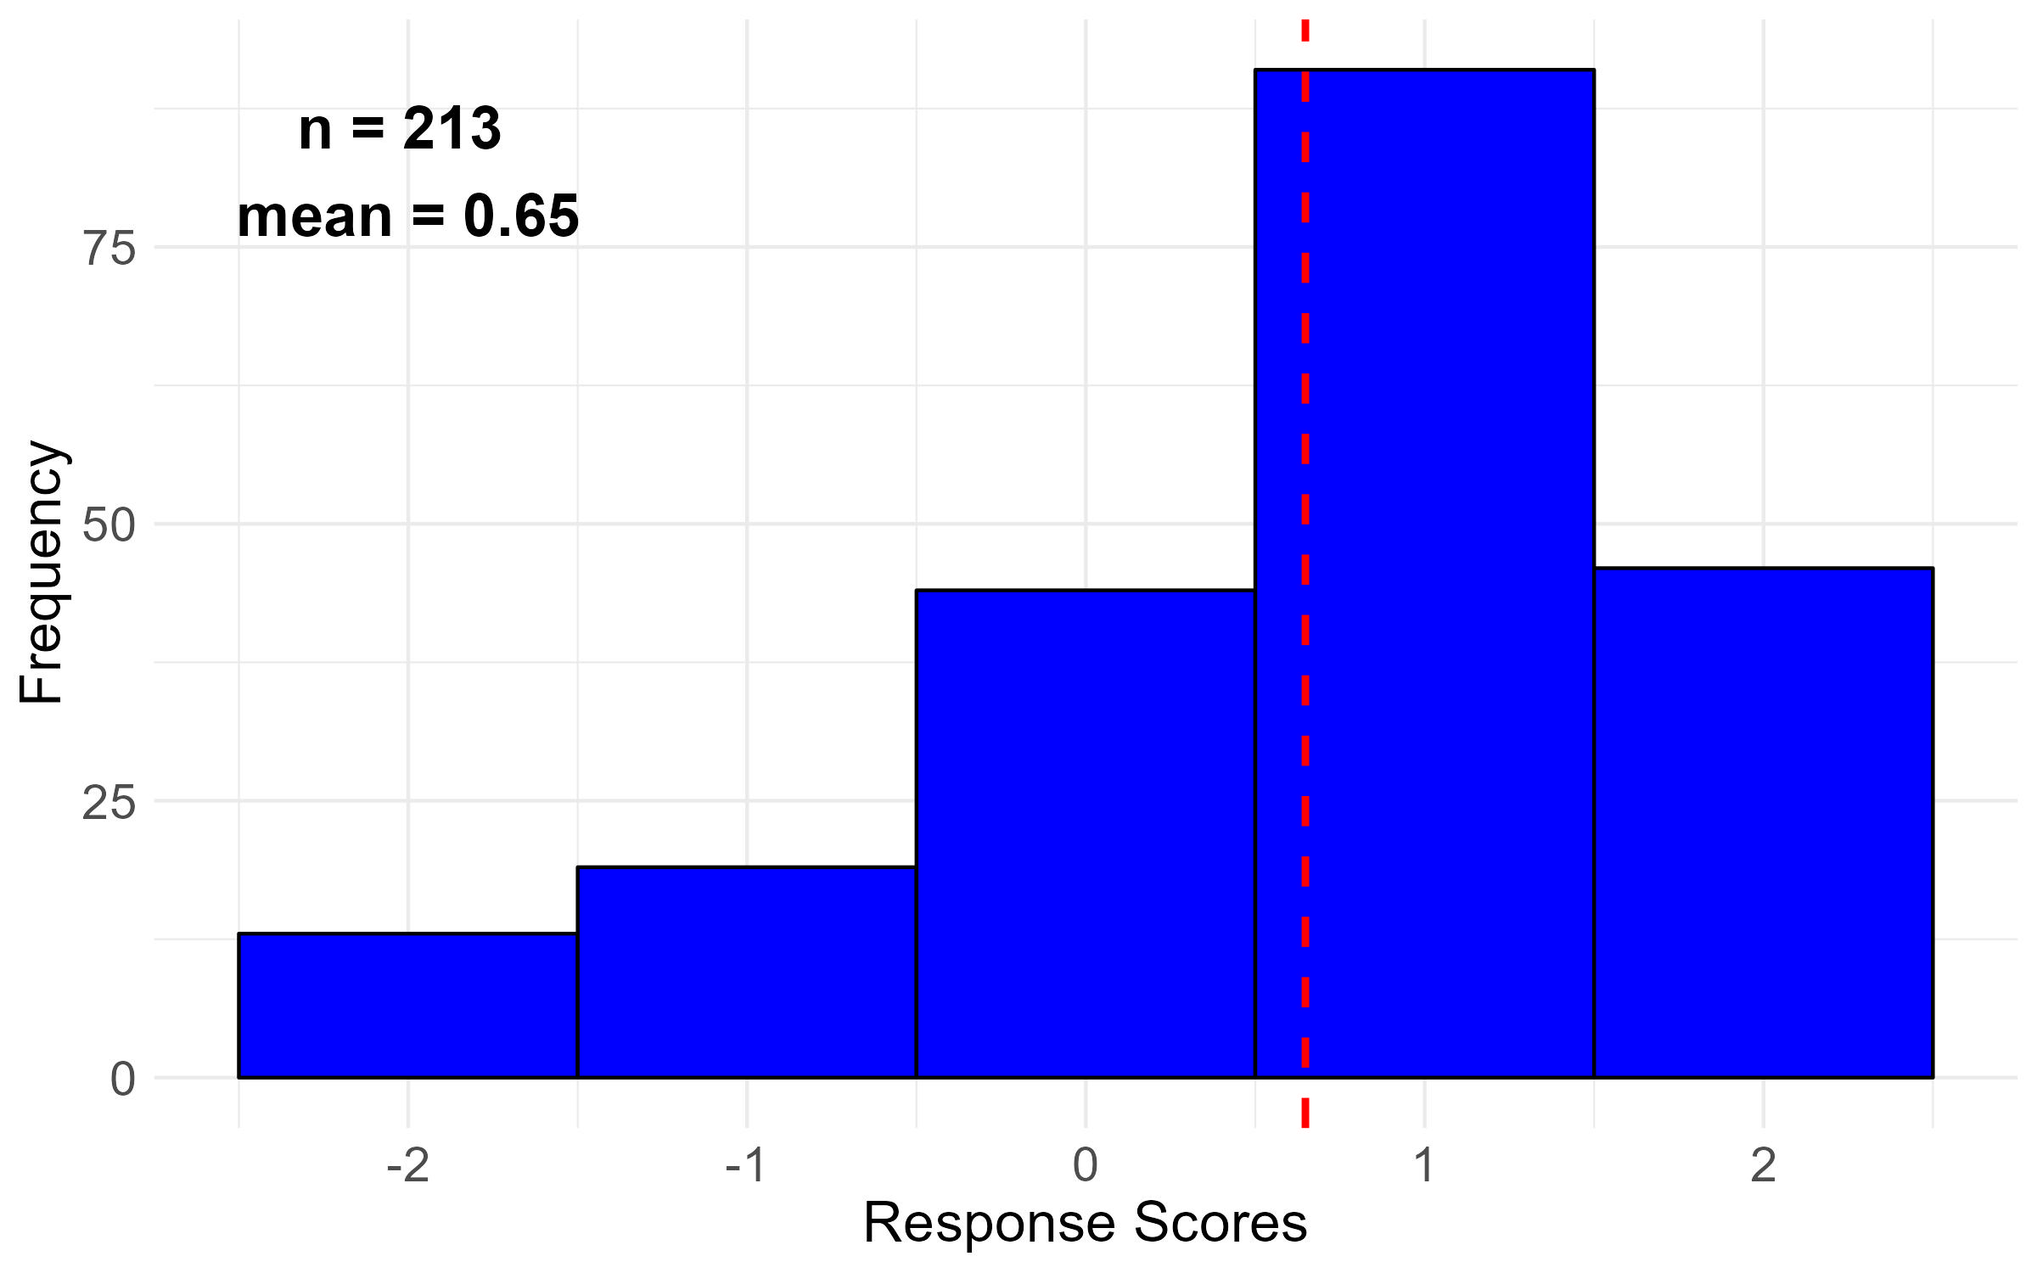
Q02: My college/ school/ library respects faculty recommendations on the selection and evaluation of faculty

Slide 25
Q02: My college/ school/ library respects faculty recommendations on the selection and evaluation of faculty
Overall Responses by Job Classification

Slide 26
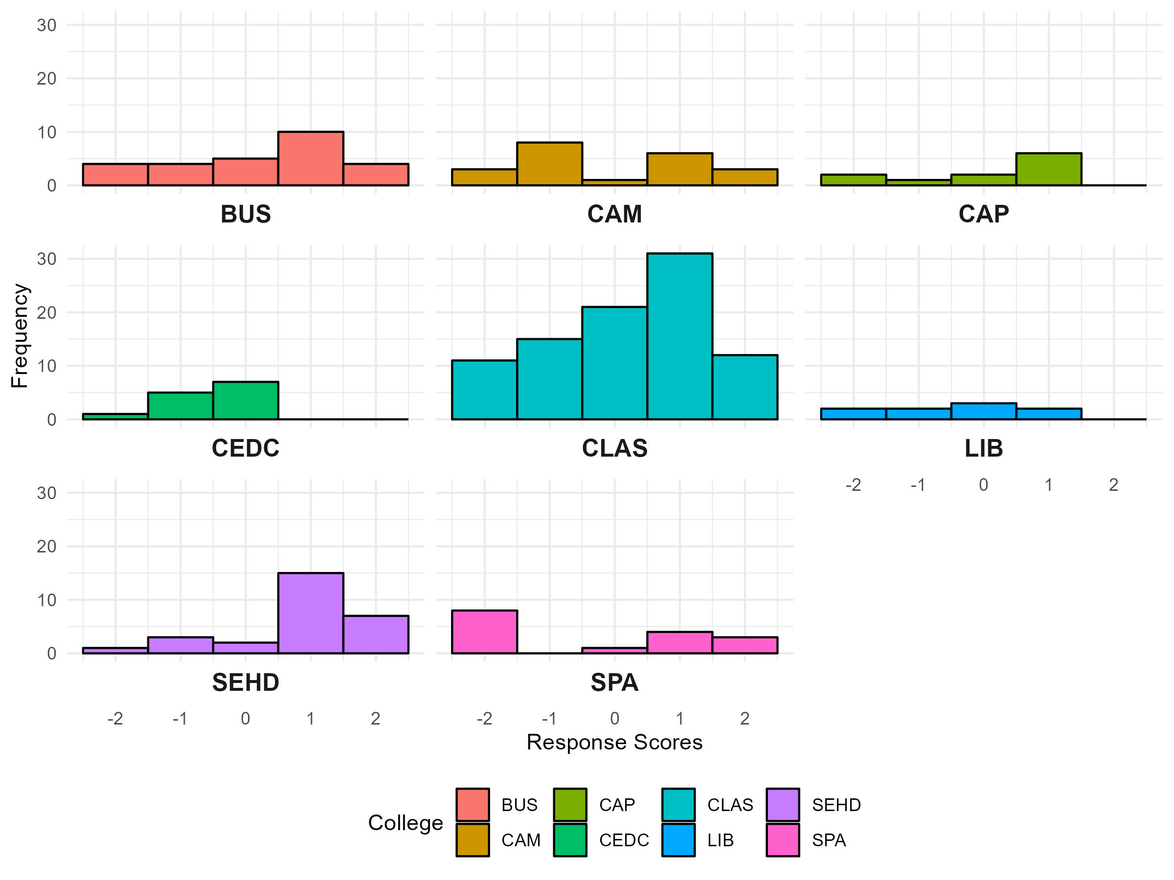
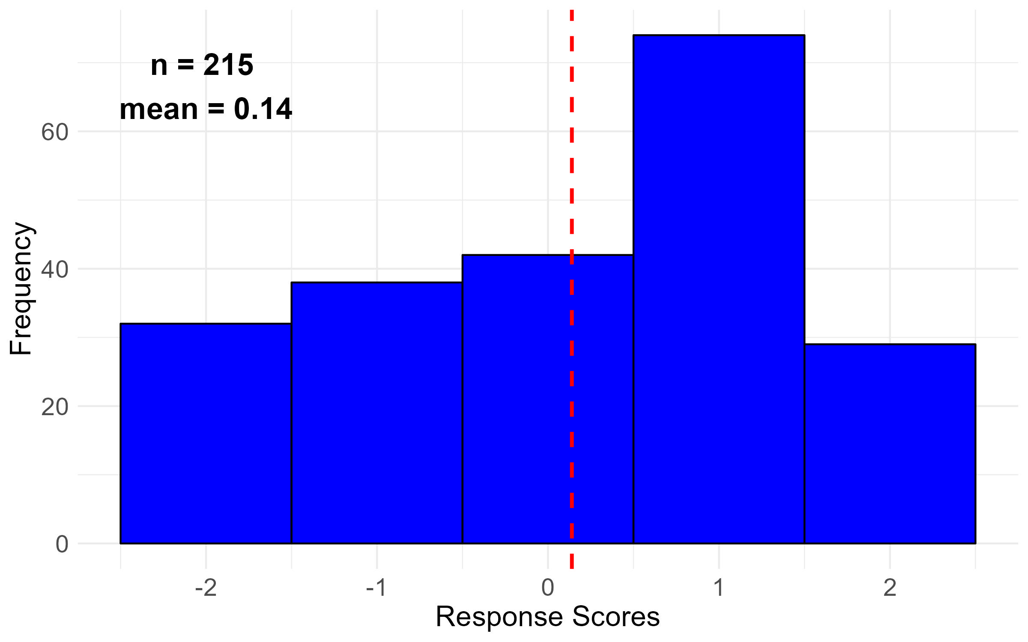
Q03: My college/ school/ library administration seeks meaningful faculty input on issues (such as planning) in which the faculty has appropriate interest but not principal responsibility.

Slide 27
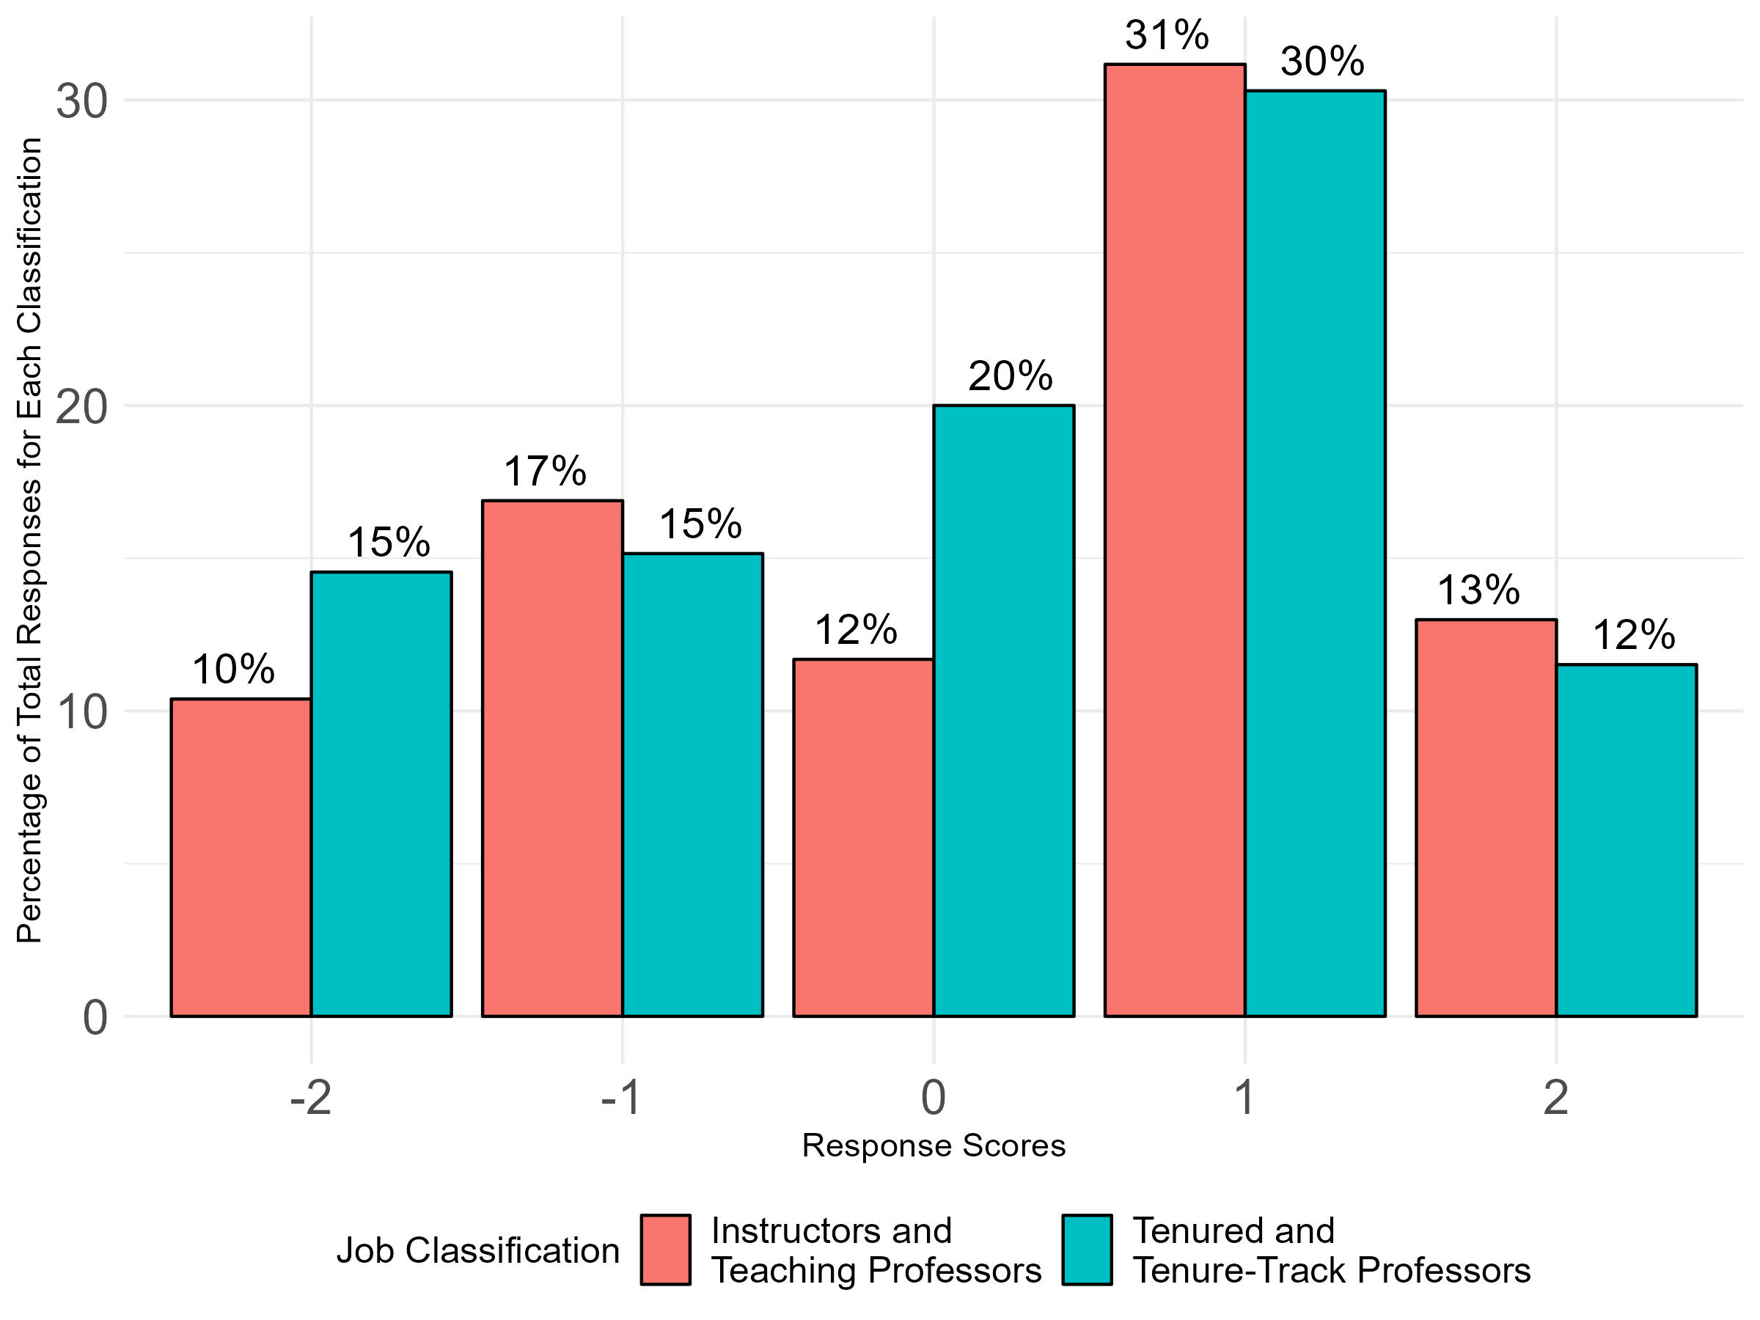
Q03: My college/ school/ library administration seeks meaningful faculty input on issues (such as planning) in which the faculty has appropriate interest but not principal responsibility.
Overall Responses by Job Classification

Slide 28
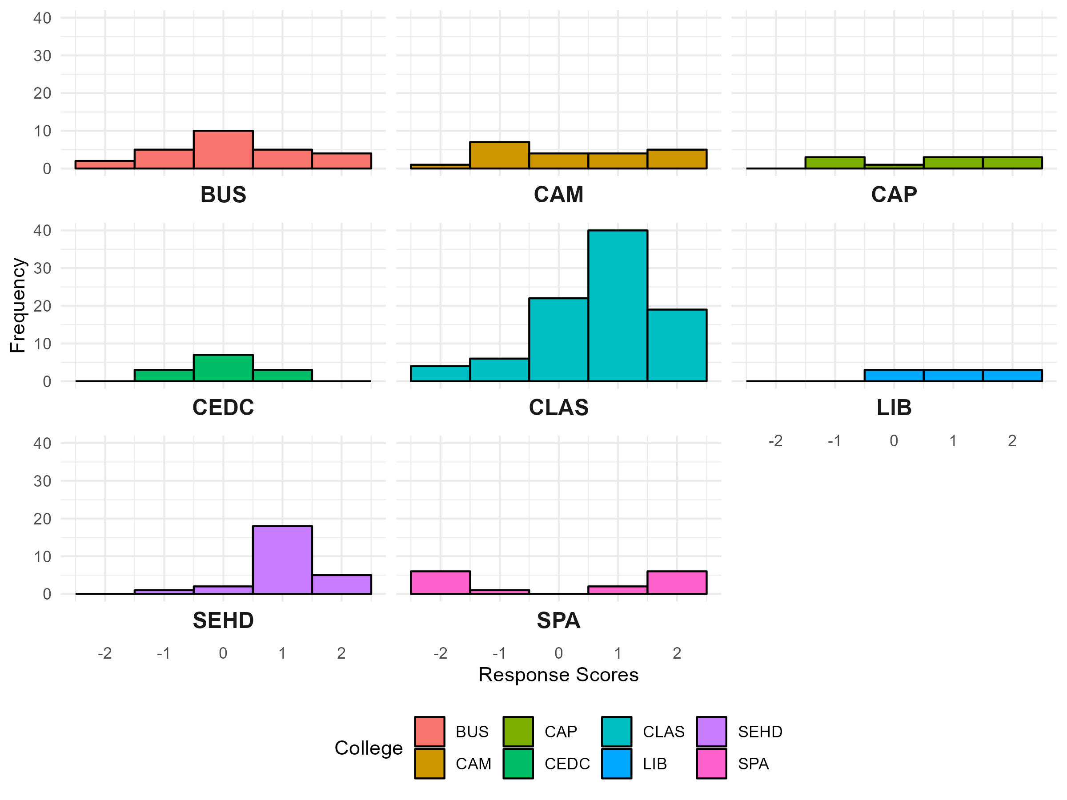
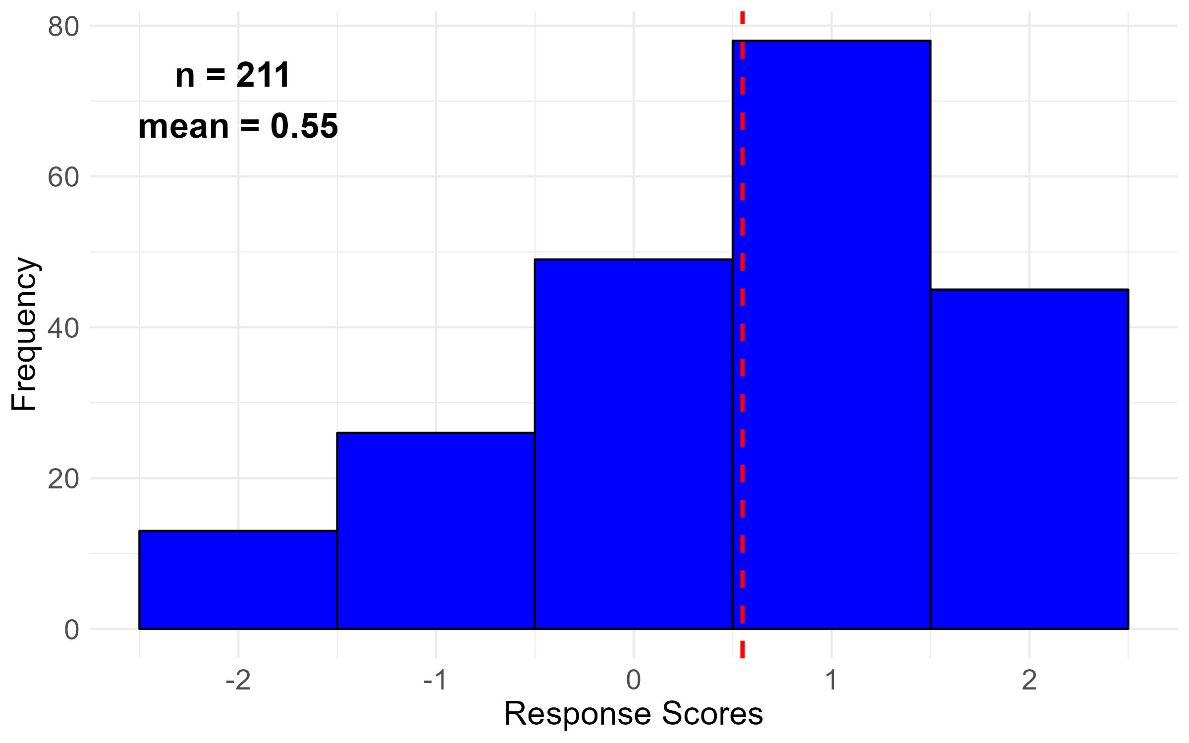
Q04: My college/ school/ library administration supports faculty shared governance.

Slide 29
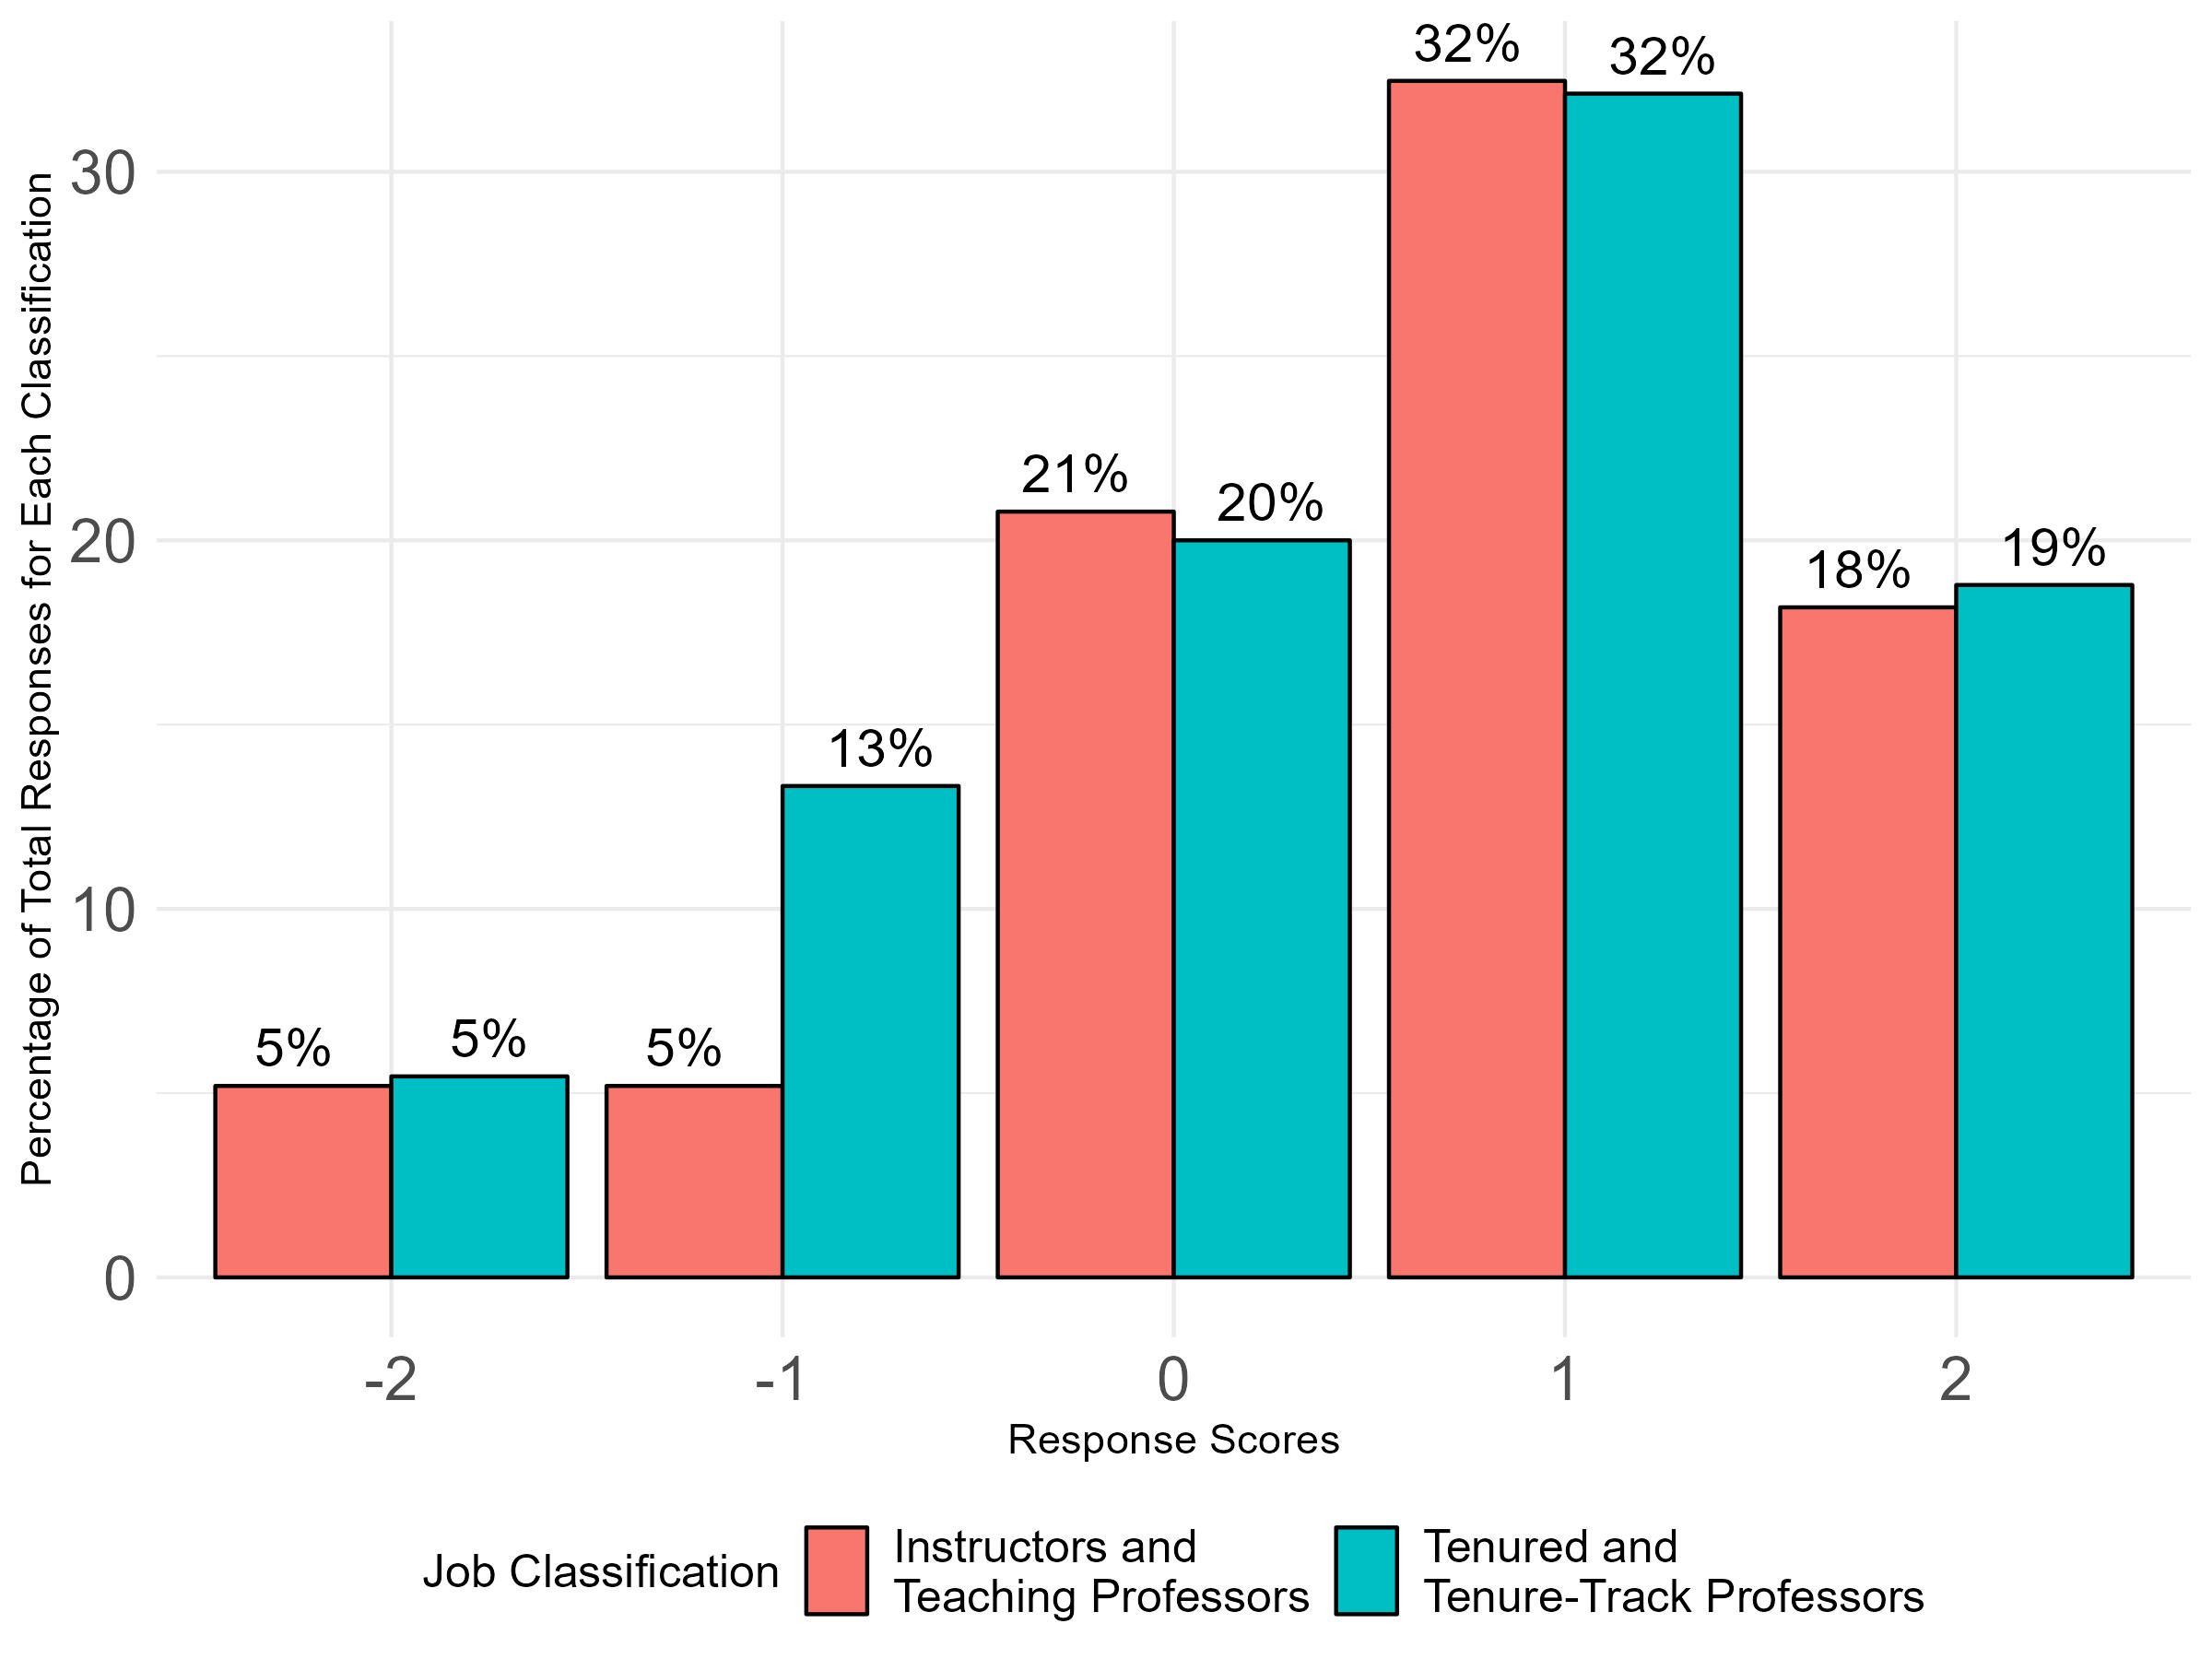
Q04: My college/ school/ library administration supports faculty shared governance.
Overall Responses by Job Classification

Slide 30
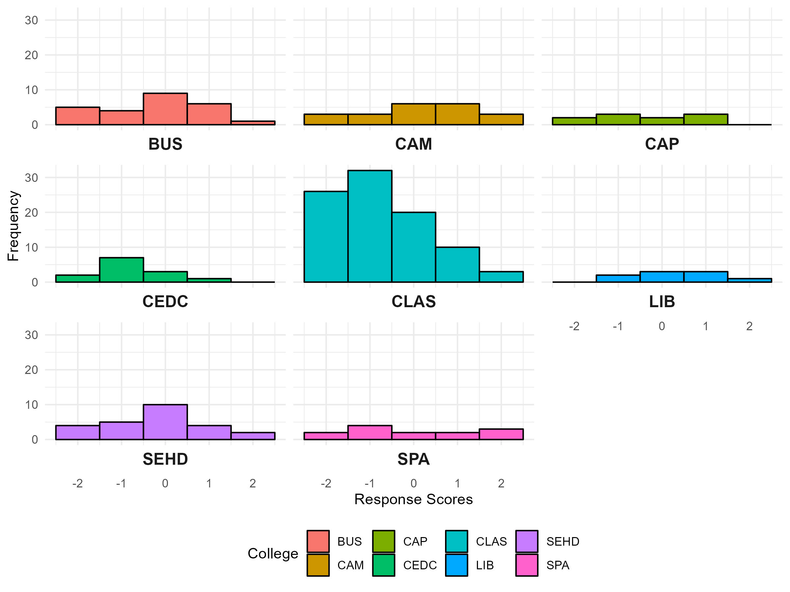
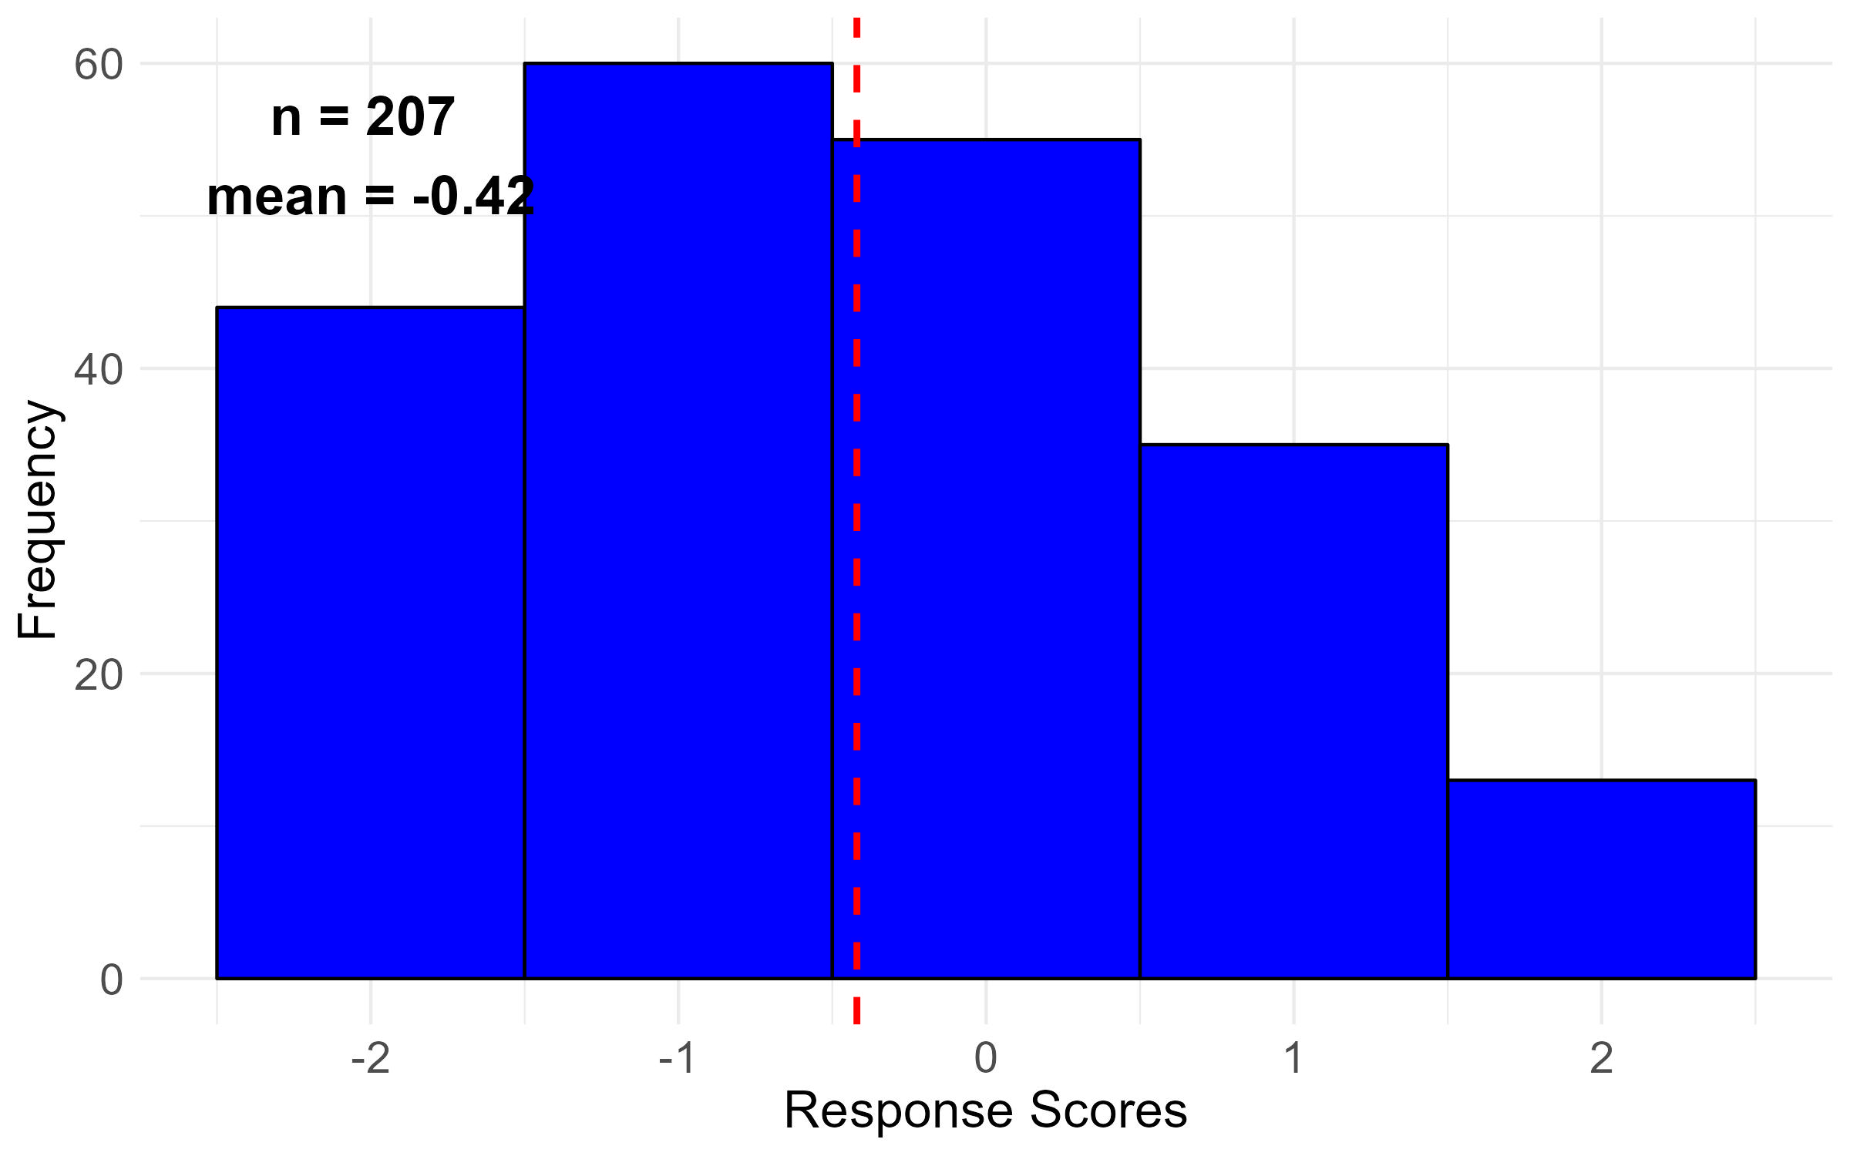
Q05: University-level administration supports faculty shared governance.

Slide 31
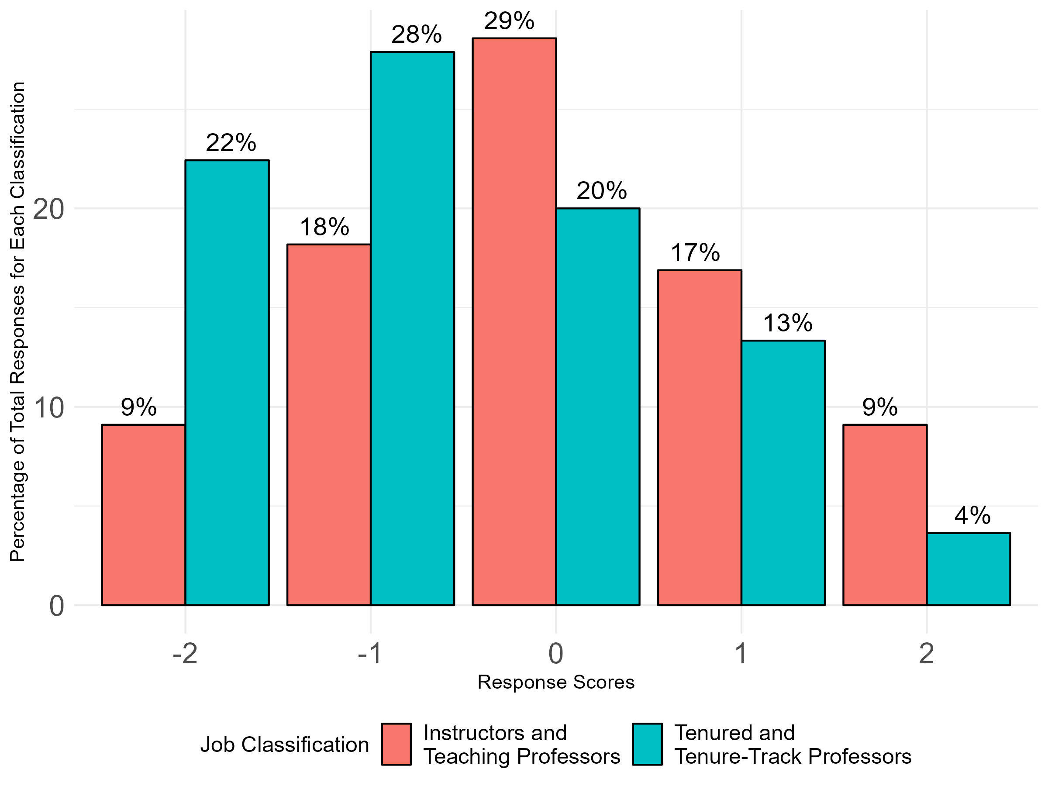
Q05: University-level administration supports faculty shared governance.
Overall Responses by Job Classification

Slide 32
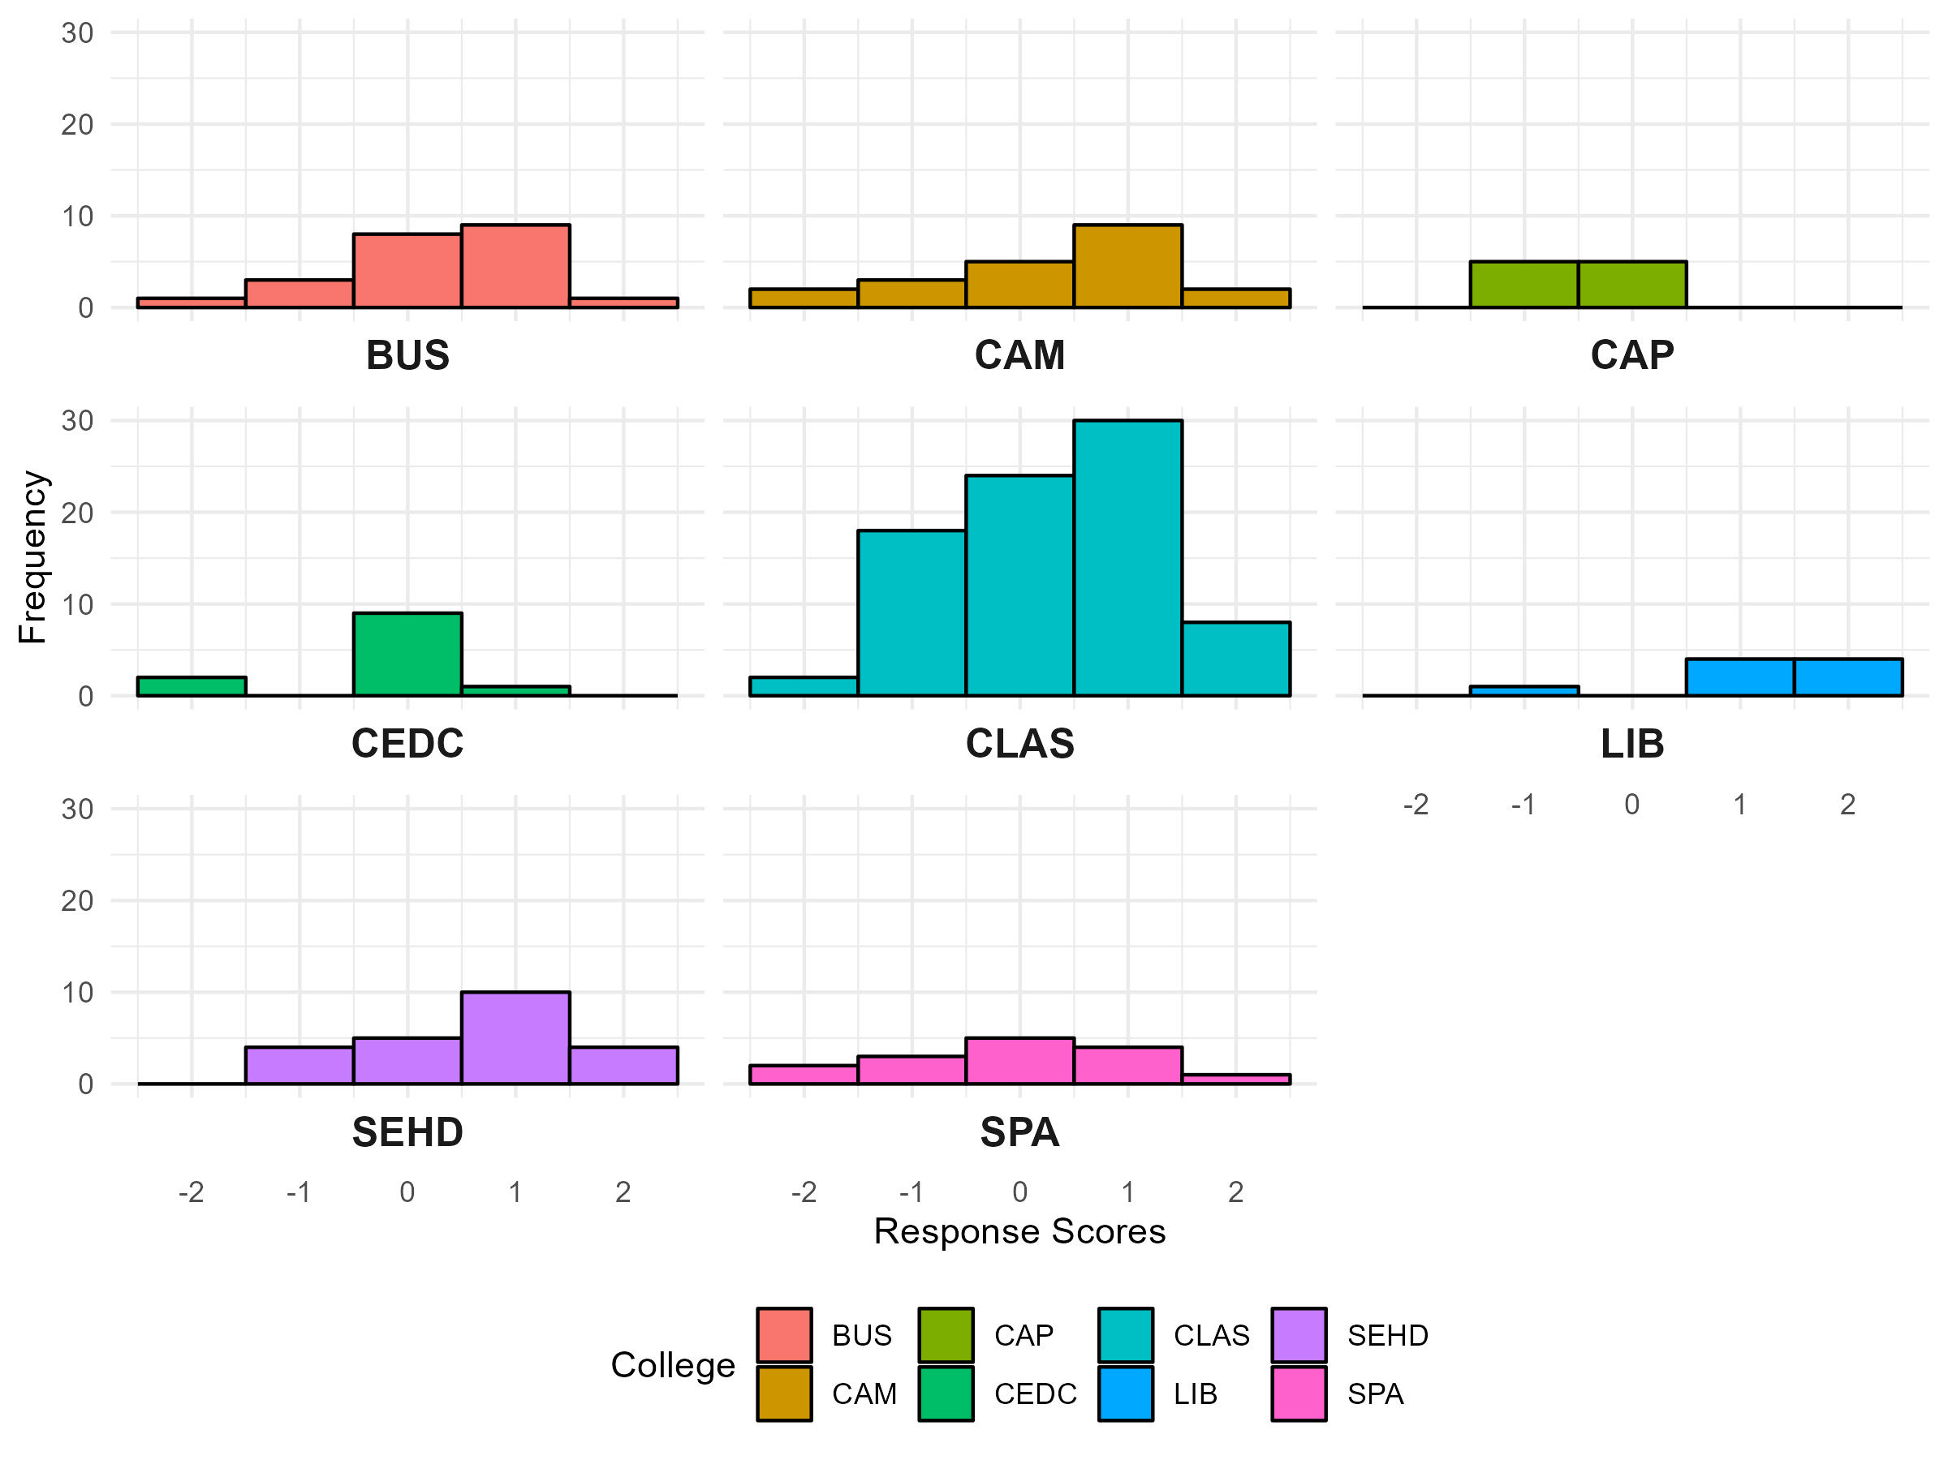
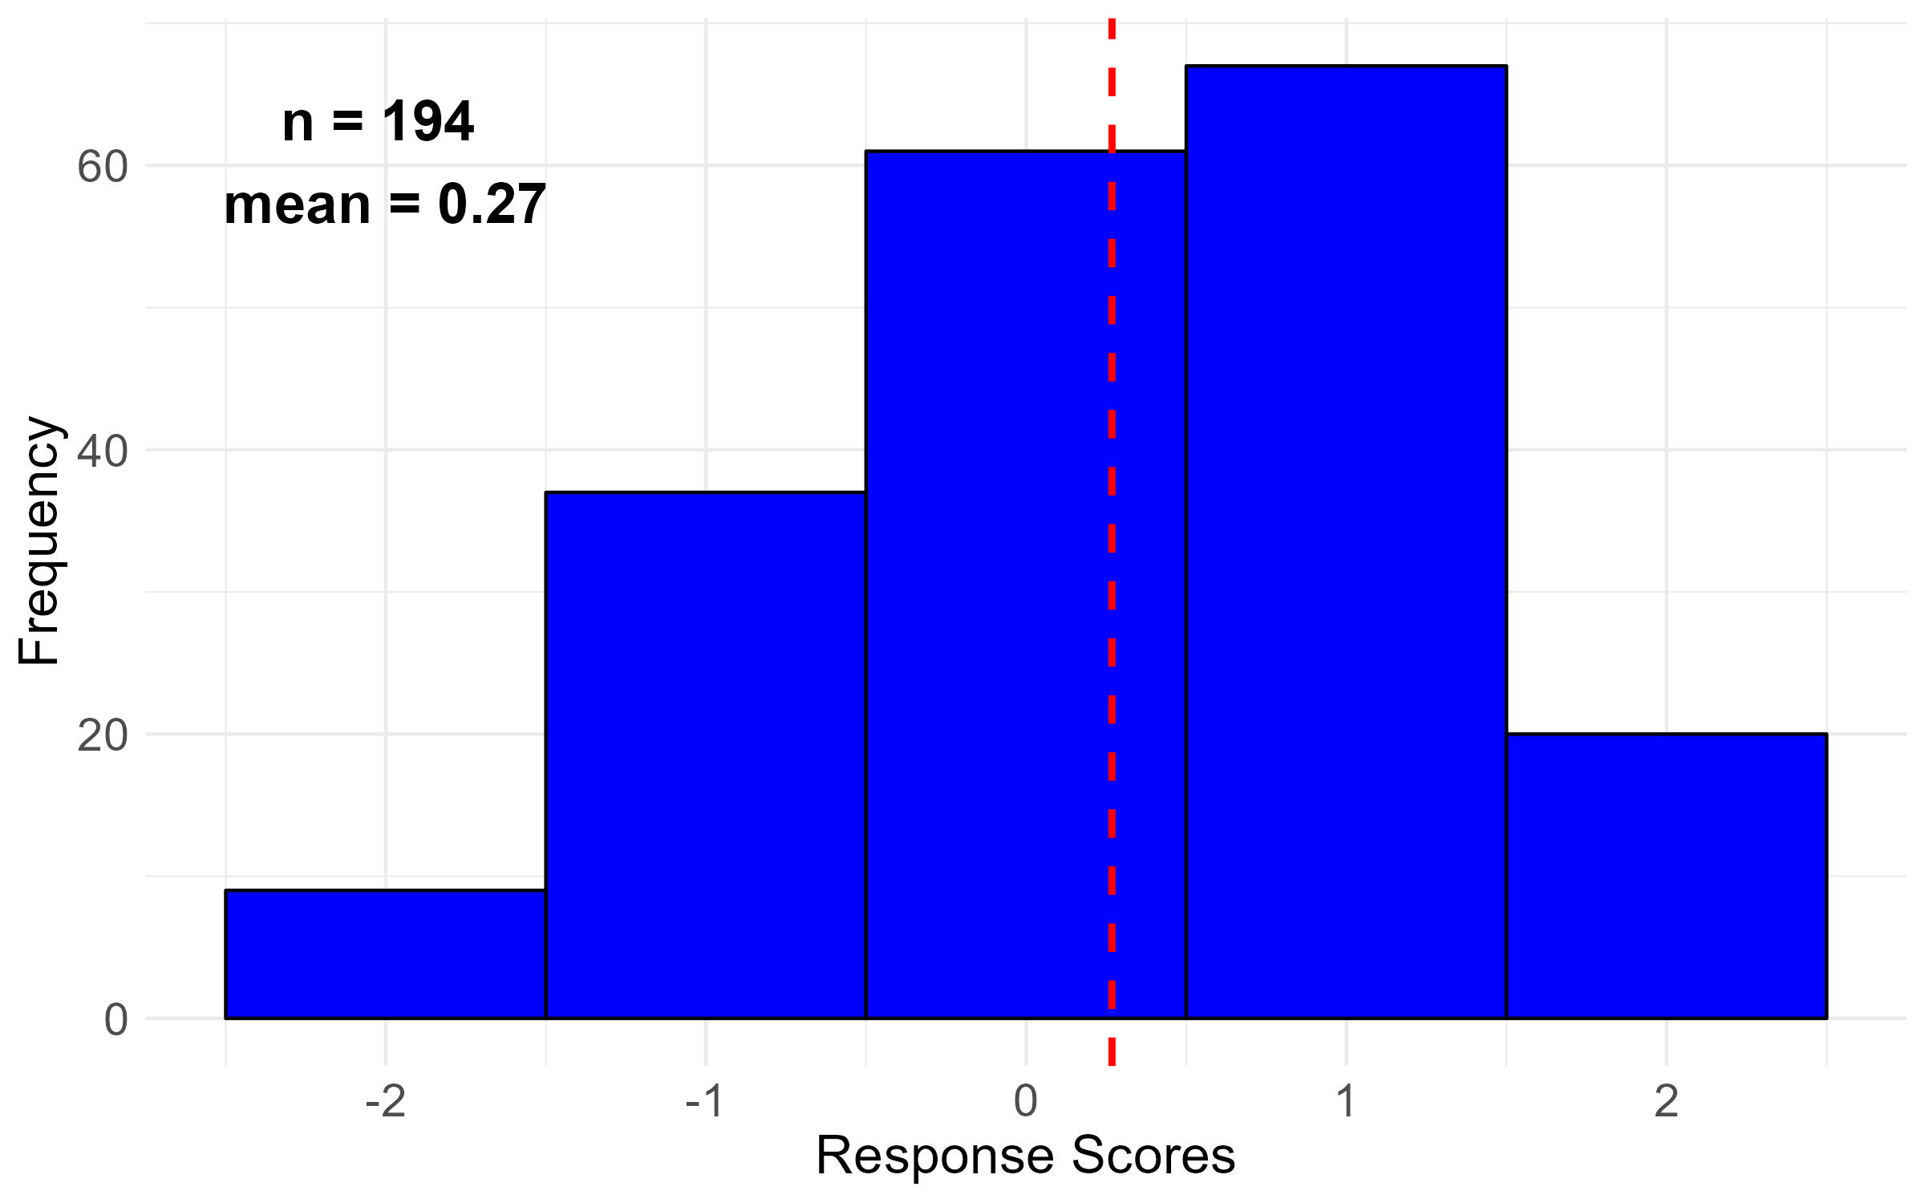
Q08: Shared governance processes and responsibilities are clearly defined in college/ school/ library governance documents (e.g., bylaws).

Slide 33
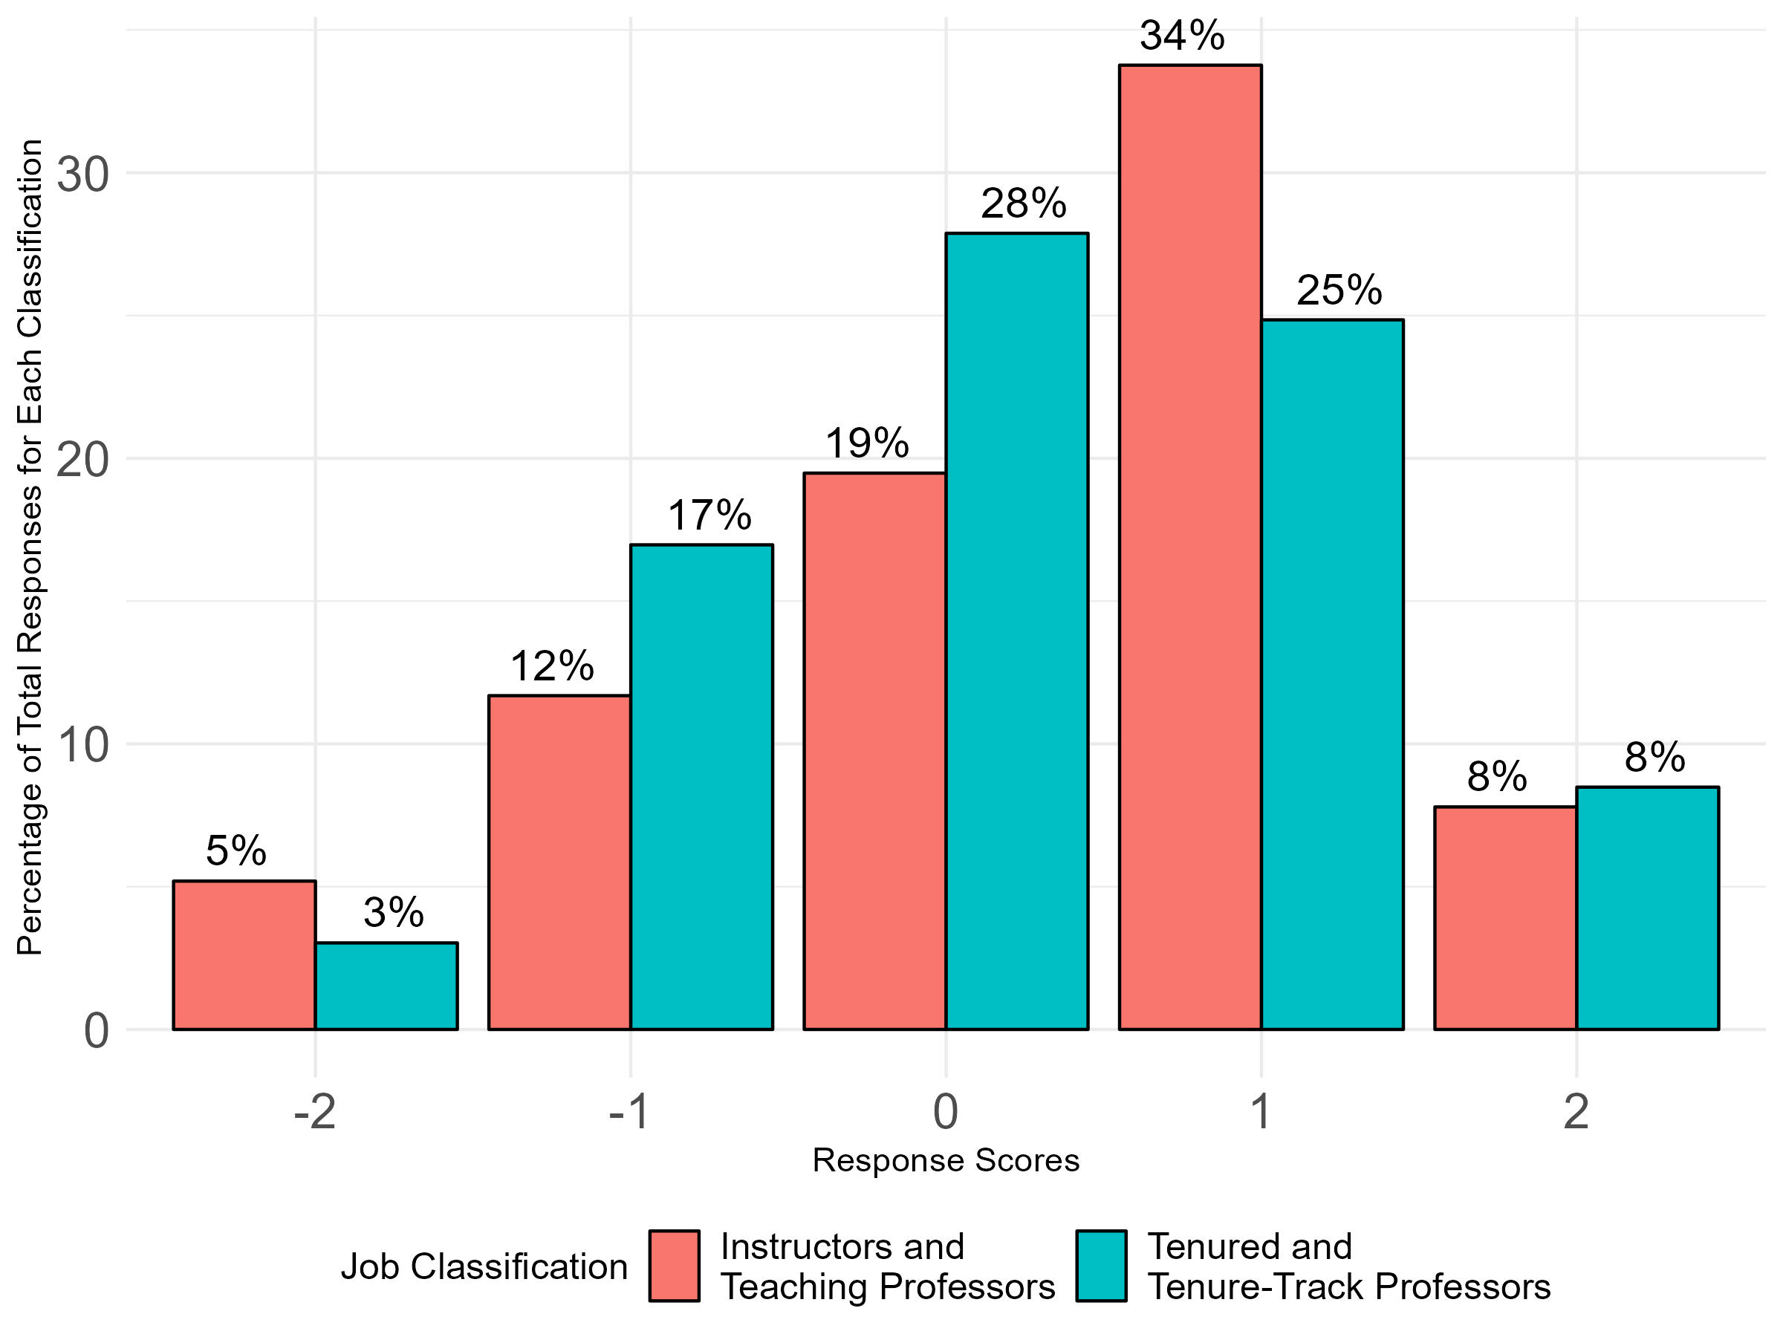
Q08: Shared governance processes and responsibilities are clearly defined in college/ school/ library governance documents (e.g., bylaws).
Overall Responses by Job Classification

Slide 34
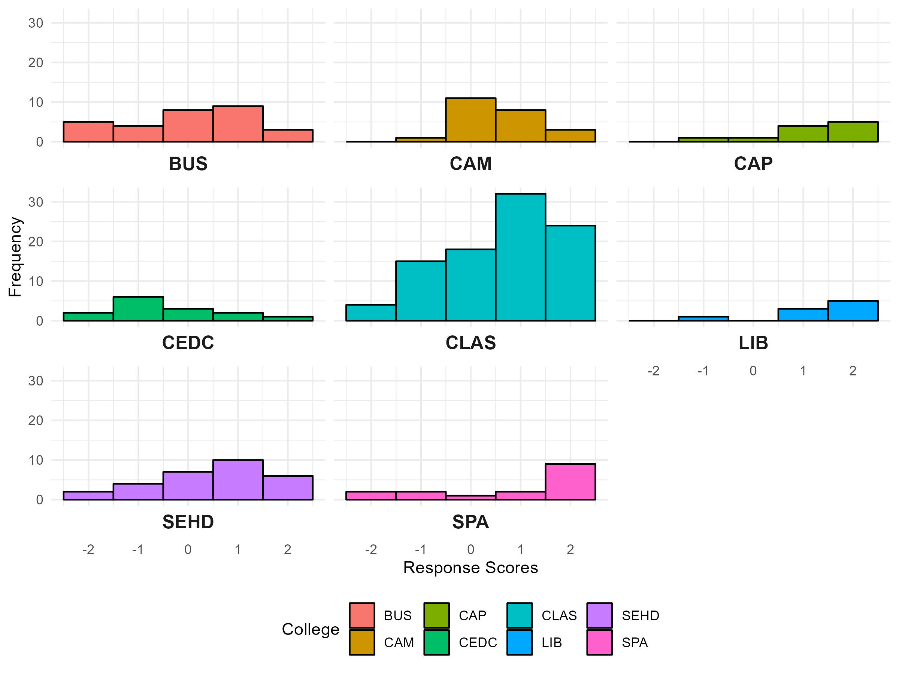
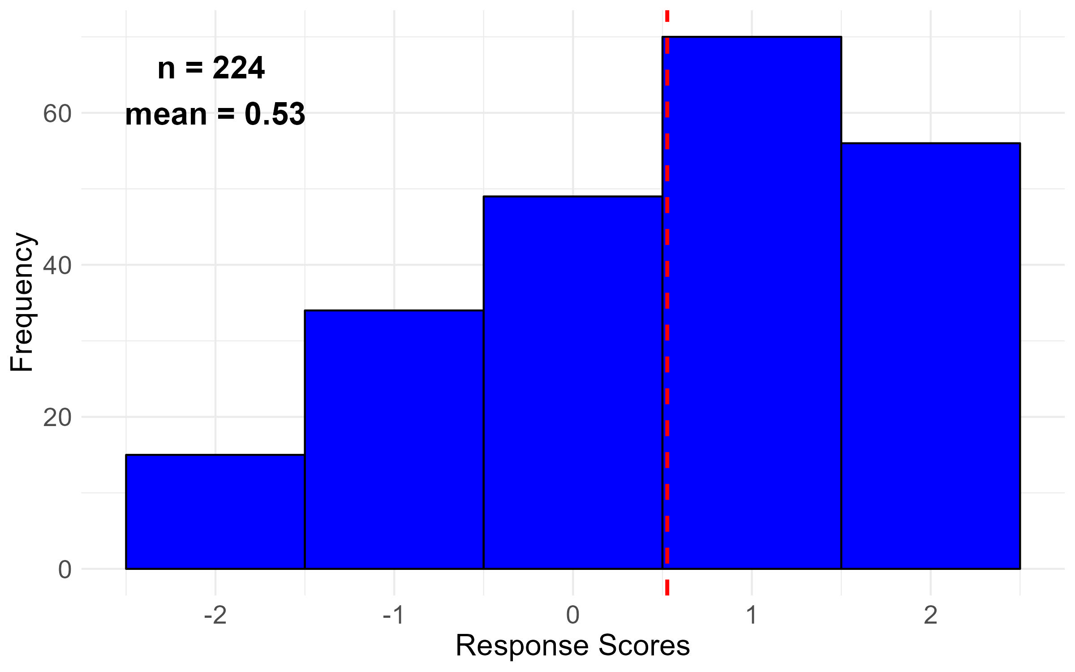
Q11: I am involved in faculty shared governance in my school, college, or library.

Slide 35
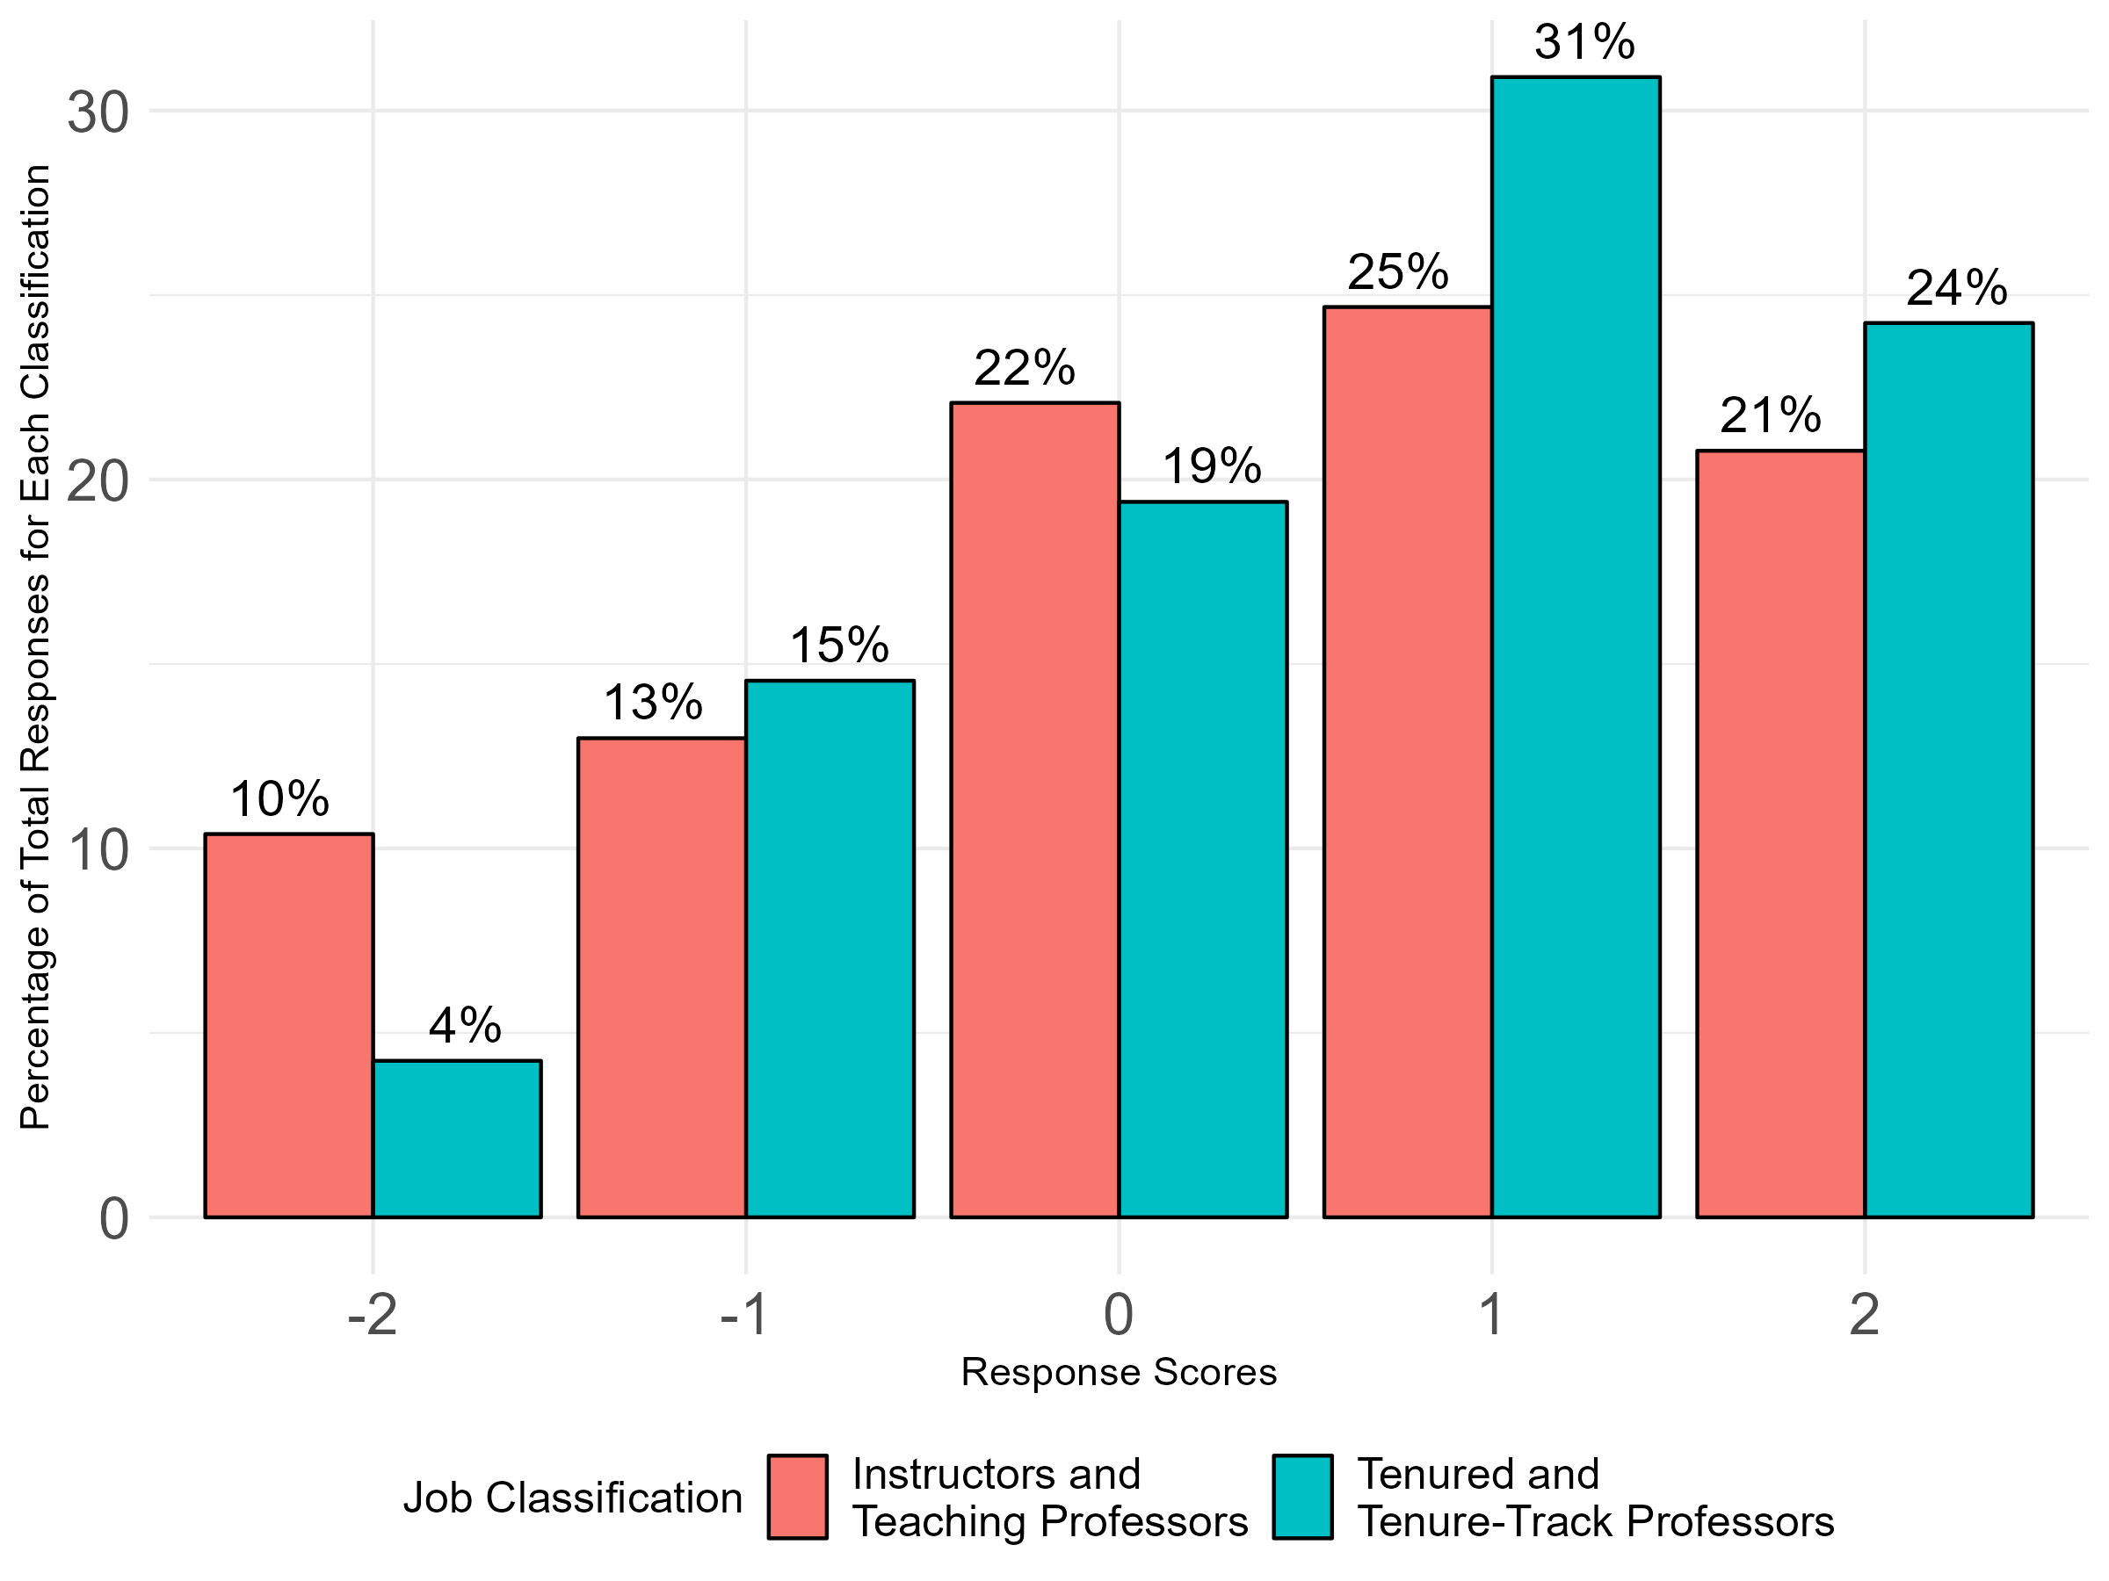
Q11: I am involved in faculty shared governance in my school, college, or library.
Overall Responses by Job Classification

Slide 36
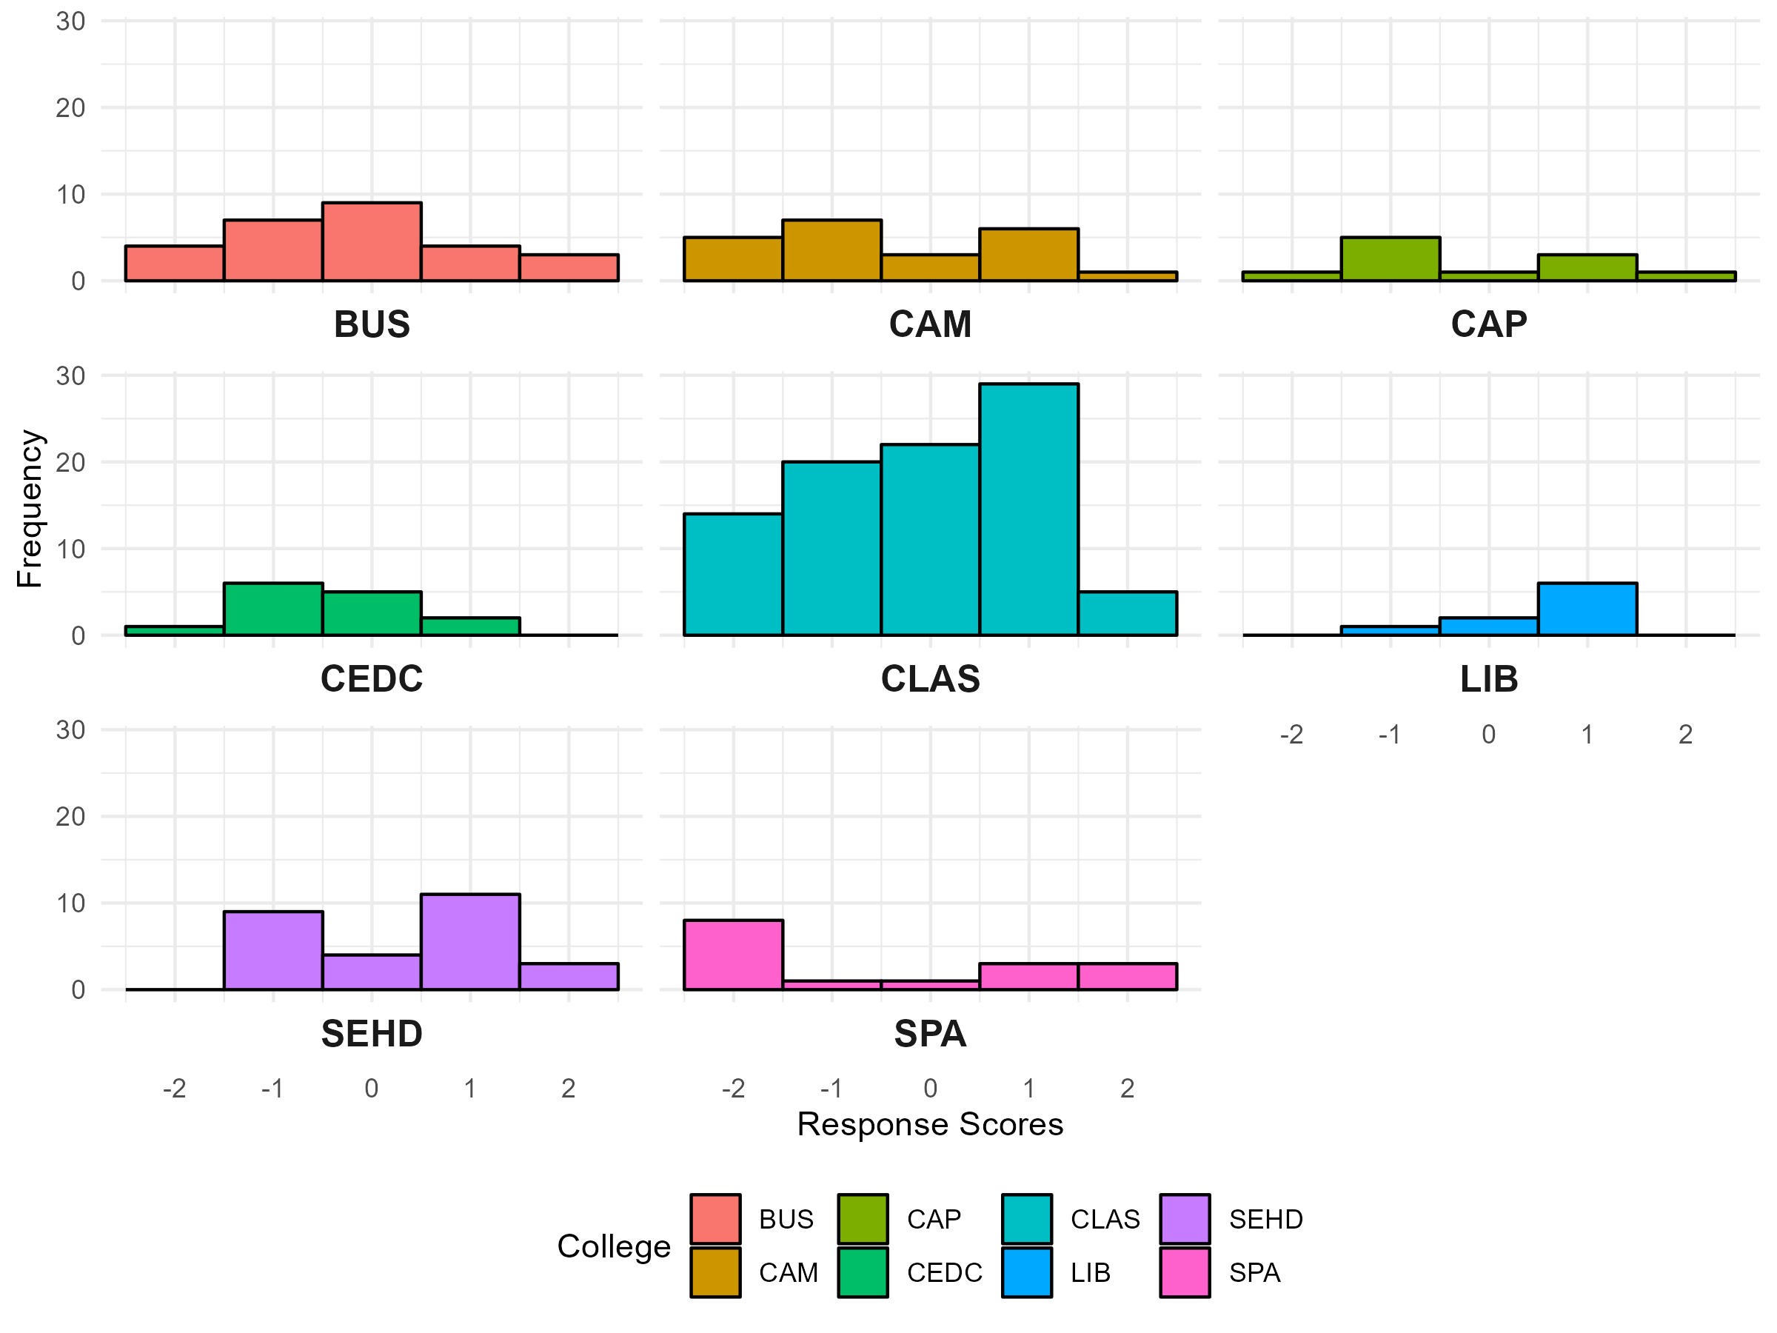
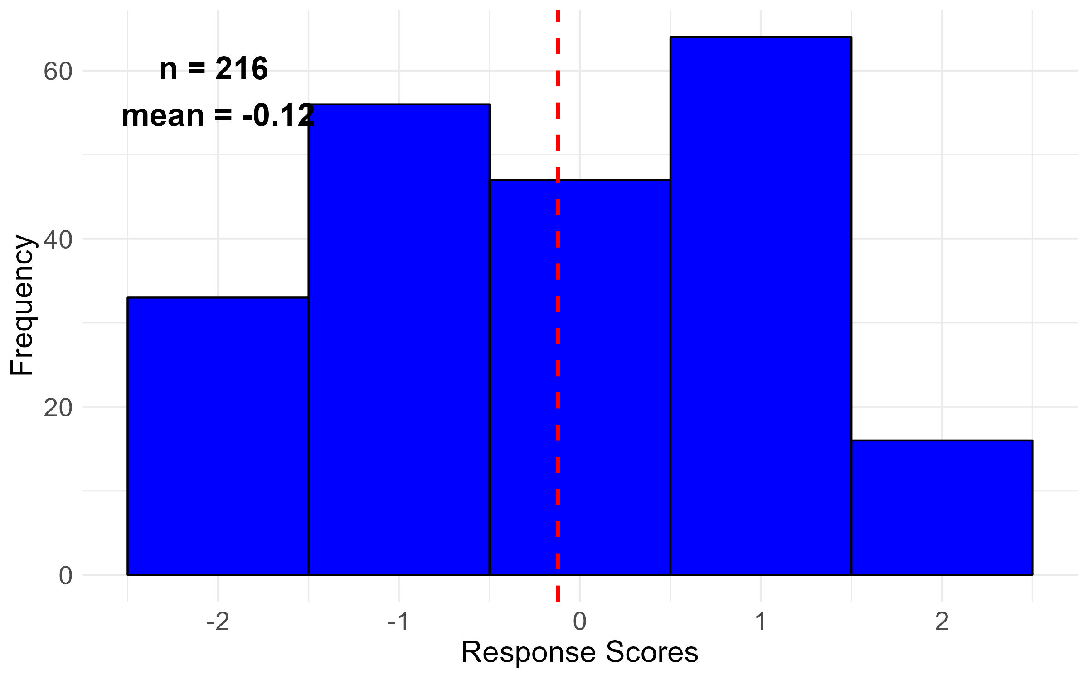
Q12: I am satisfied with the state of faculty shared governance at my college/ school/ library.

Slide 37
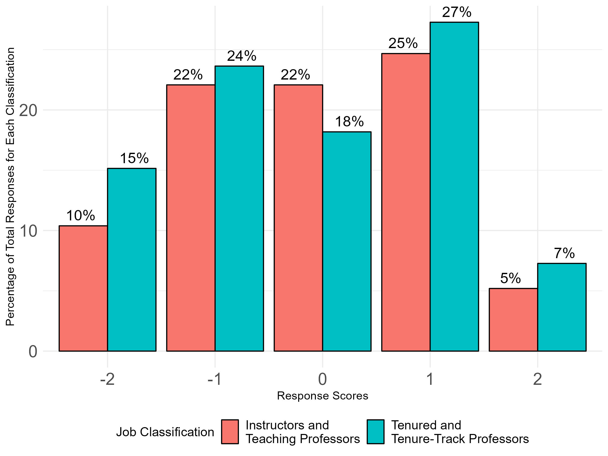
Q12: I am satisfied with the state of faculty shared governance at my college/ school/ library.
Overall Responses by Job Classification

Slide 38
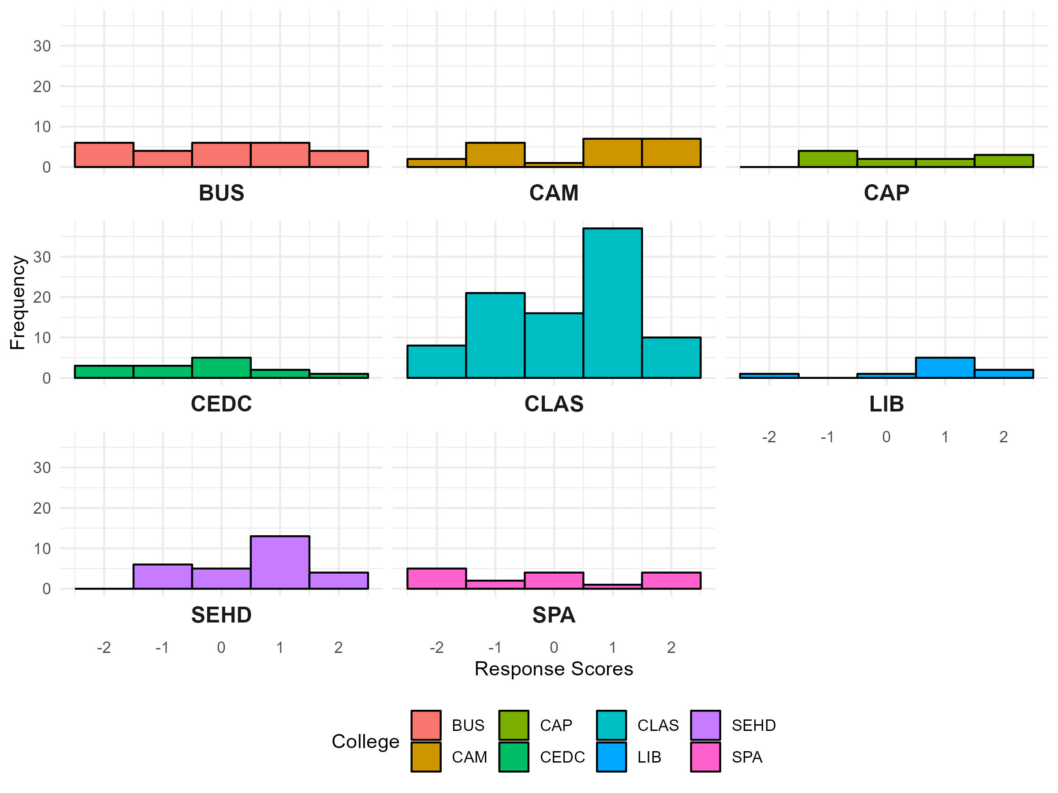
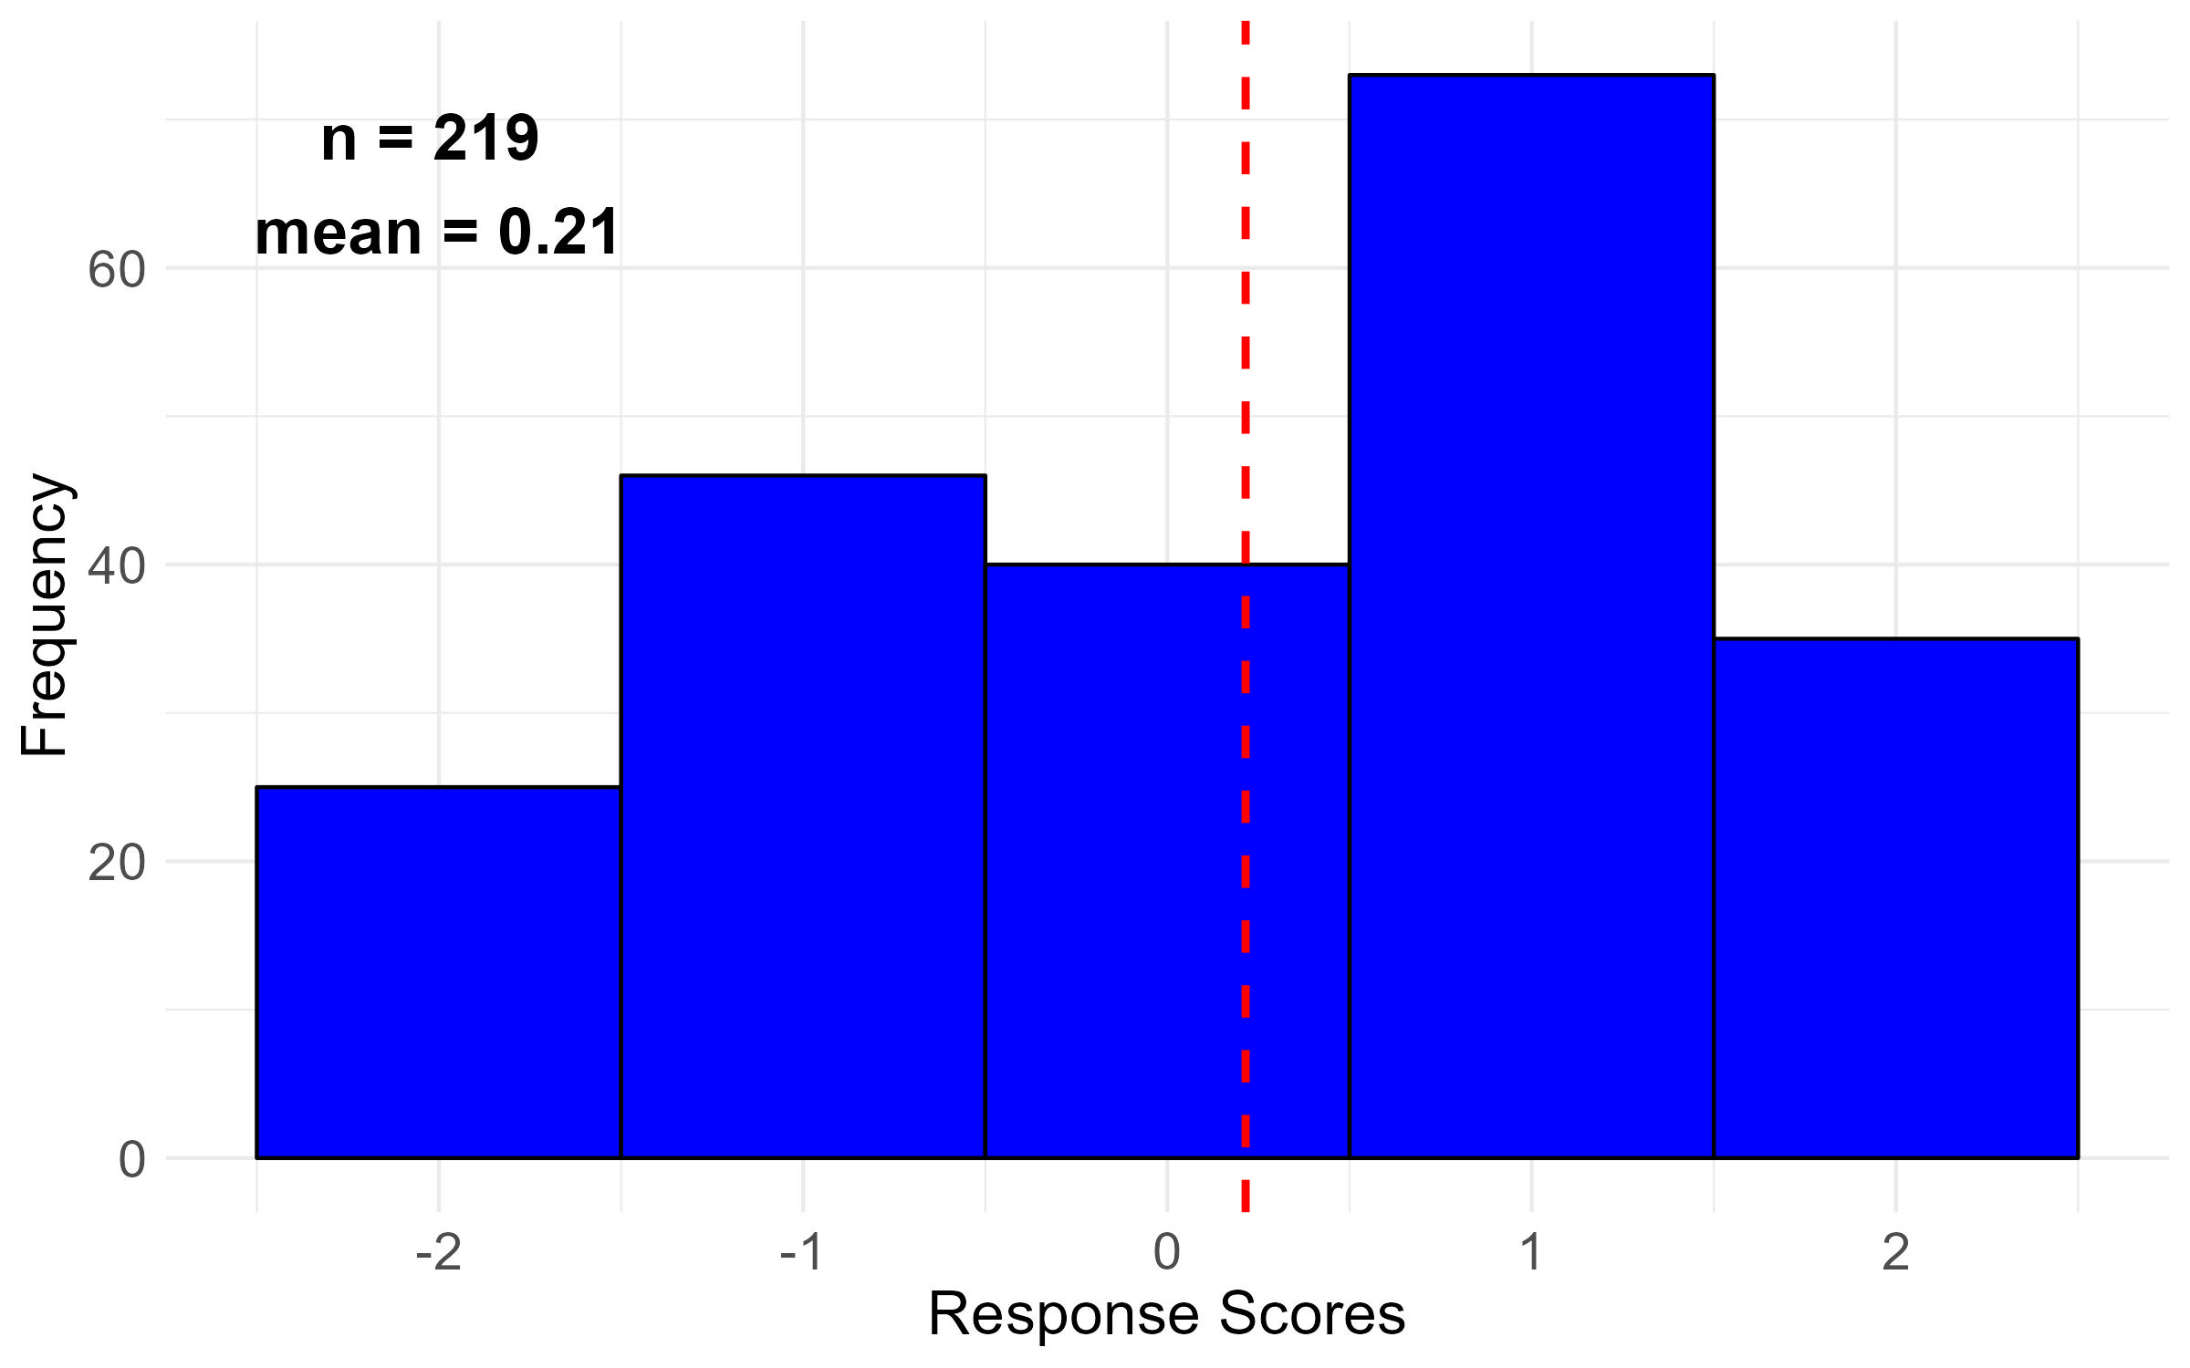
Q13: Faculty have a meaningful impact on college/ school/ library policies that matter to me.

Slide 39
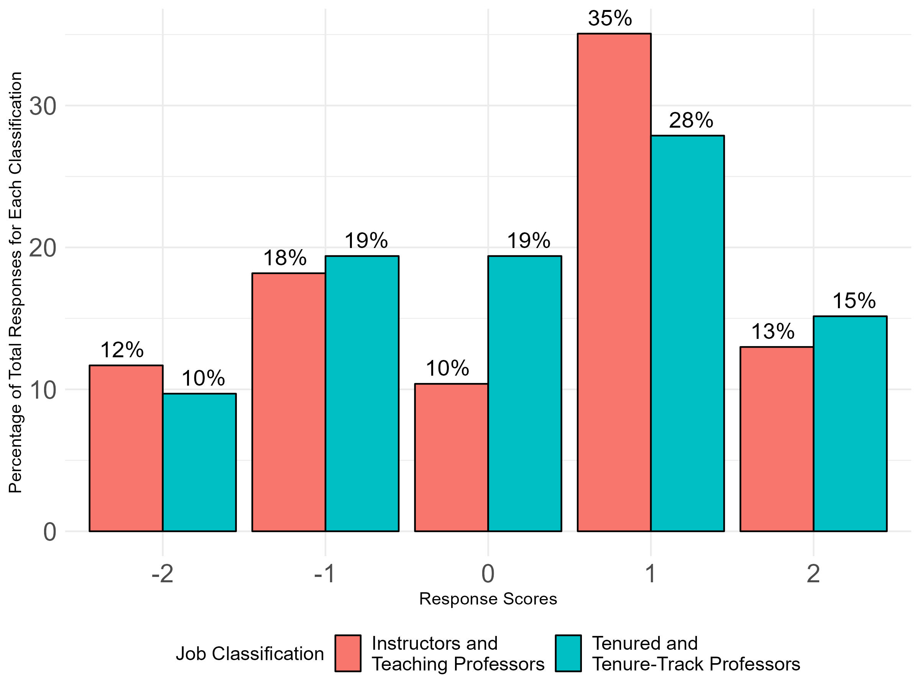
Q13: Faculty have a meaningful impact on college/ school/ library policies that matter to me.
Overall Responses by Job Classification

Slide 40
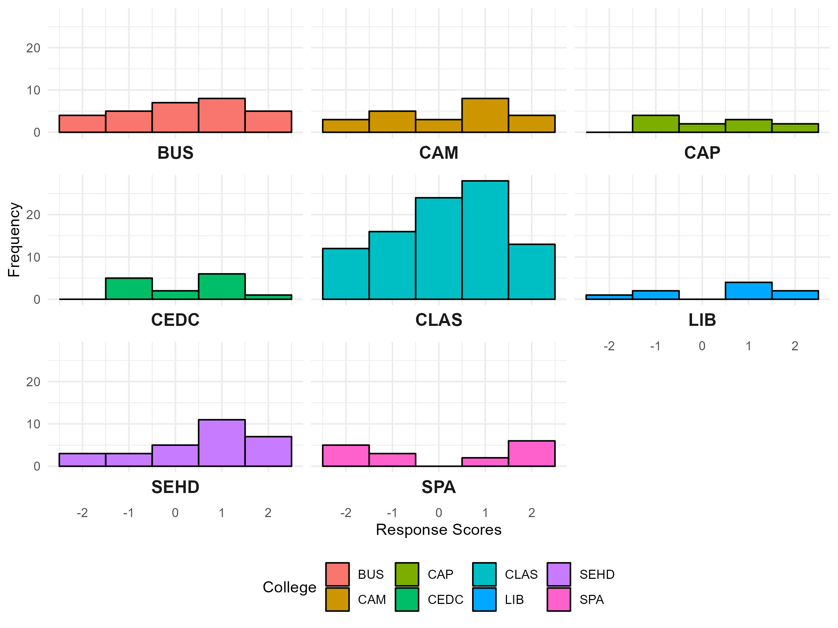
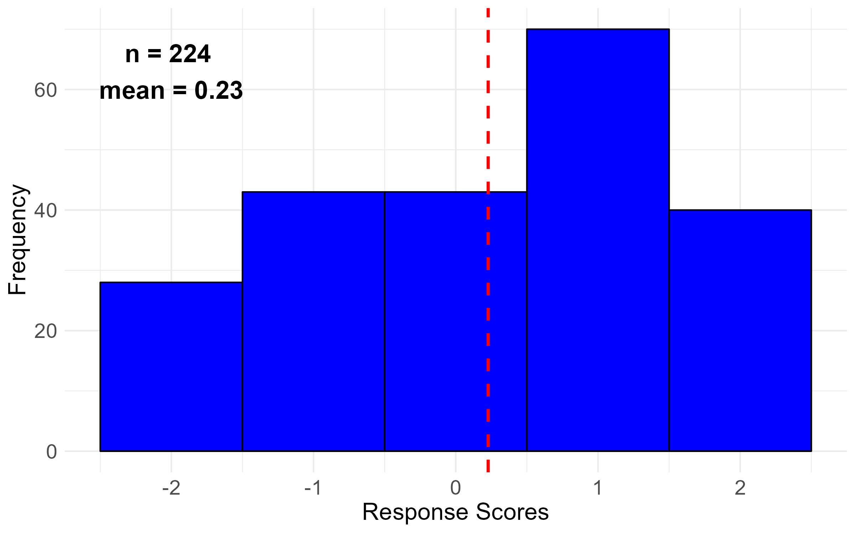
Q14: I feel comfortable speaking up in college/ school/ library faculty meetings, even if my position differs from that of administrative leaders.

Slide 41
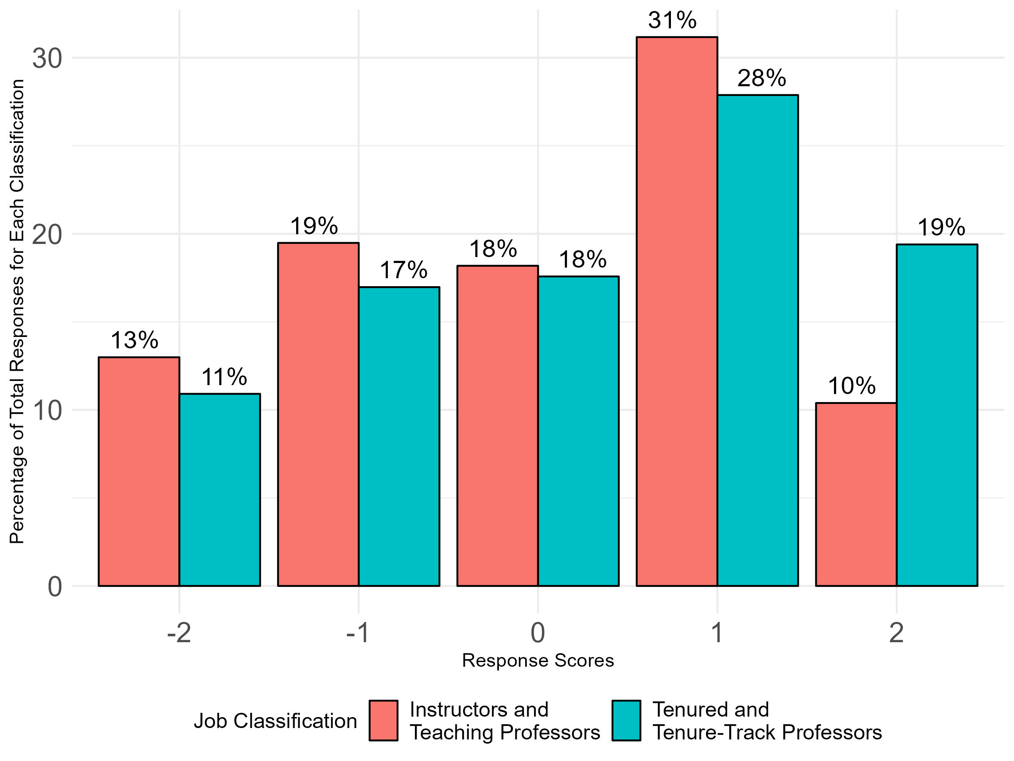
Q14: I feel comfortable speaking up in college/ school/ library faculty meetings, even if my position differs from that of administrative leaders.
Overall Responses by Job Classification

